Slide 1
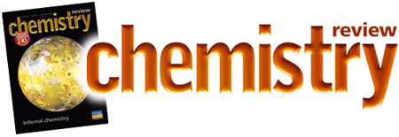


Chemistry Review Exercise
SOIL 4234 Laboratory No. 1

Slide 3
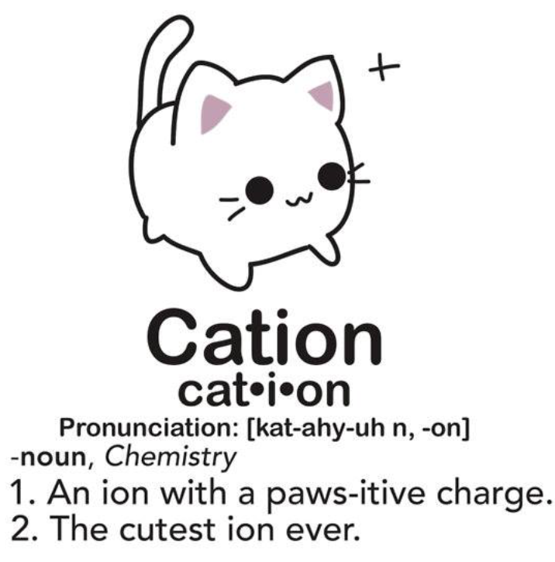
Binary compounds
The cation is always named first and the anion second
A simple cation (obtained from a single atom) takes its name from the name of the element
A simple anion is named by taking the first part of the element name (the root) and adding –ide.
Example: NaCl sodium chloride
KBr potassium bromide
CaO calcium oxide

Slide 4
Ternary compounds
Suffixes ite and ate
“ite” – element not in its highest valence
“ate” – element in its highest valence
Example: sulfite, sulfate

Slide 5
Nomenclature of Compounds
For cations having two valence states, the higher valence is ic and the lower valence is ous
Example: Cu₂O: copper (I) oxide - cuprous oxide
CuO: copper (II) oxide – cupric oxide

Slide 6
Chemical formula
X^{a+} + Y^{b-} X_{b}Y_{a}
Na¹⁺ + Cl¹⁻ Na₁Cl₁ NaCl
Al³⁺ + Cl¹⁻ AlCl₃
Al³⁺ + SO₄²⁻ Al₂(SO4)₃

Slide 7
Molecular weight
MgCl Mg = 24.3 g
Cl = 35.5 g
59.8 g
Fe₂0₃ Fe = 55.8 (2) = 111.6 g
O = 16.0 (3) = 48.0 g
159.6 g
Na₂SO₄ Na = 23.0 (2) = 46.0 g
S = 32.1 = 32.1 g
O = 16.0 (4) = 64.0 g
142.1 g

Slide 8
Equivalent weight
Equivalent weight = molecular weight
valence
Equivalent acid or base: Amount of that acid or base that can furnish 1 mole or H⁺ or OH⁻ ions.
CaCO₃ CO₃²⁻ can furnish 2 H⁺
have a valence of 2
Valences of some elements and compounds are found in pages 4 and 5 of the Chemistry review handouts

Slide 9
Percent material
Percent material = element molecular weight
total cmpd molecular weight
X 100
Percent H in H₂SO₄
H = 1(2) = 2 (2/98)*100 = 2%
S = 32(1) = 32
O = 16 (4) = 64
98

Slide 10
Number of ions in an acre (3)
(Weight/acre) x (1mol element/molecular weight of element) x (# mol H⁺/# mol N) x (Avogadro’s constant)
Mole ratio of N and H in NH₃
NOTE: Convert weight to appropriate unit
Avogadro’s constant = 6.02 x 10²³
number of units in one mole of any substance (defined as its molecular weight in grams). The units may be electrons, atoms, ions, or molecules, depending on the nature of the substance and the character of the reaction (if any).

Slide 11
pH average
pH = -log 10^{-pH}
Step1: H⁺ = -log 10^{-pH}
Step 2: Average = total/no. of items
Step 3: pH = log average

Slide 12
No. 6
Step 1. Convert µmol P to lb P
g soil lb soil
1.a. First convert the μmol P to lb P
1.b. Then convert g soil to lb soil
1 mol = 1,000,000 μmol
Step 2. Do ratio and proportion
1 acre has 2,000,000 lbs soil

Slide 13
Titration
Step 1. Determine the no. of moles of titrant
Step 2. Determine the ratio of titrant and titrand
Step 3. Determine the no. of moles of titrand
Step 4. Determine the molarity of titrand
Titrant is sulfuric acid
Titrand is sodium hydroxide

Slide 14
No. of grams compound (8)
ppm = mg/L = 10⁻³g/L
gram x mole element x mole cmpd x g cmpd
L gram element mole element mol cmpd

Slide 15
Calculating no. of g for a solution (9)
M = mol/L
mol x mole cmpd x g cmpd
L mole element mol cmpd
How many moles element in a given compound?

Slide 16
Oxidation state
RULES
The oxidation state of an element by itself is 0
Hydrogen is always 1⁺
Oxygen is always 2⁻

