Slide 1
Soil Nutrient Management SOIL 4234
Wednesdays 1:30 – 3:30
3:30 – 5:30

Slide 2
SOIL 4234: Soil Nutrient Management
Course Website: http://pss.okstate.edu/soil4234
Text:
Lab procedures, assignment sheets, and literature will be available on the course website
Not provided by the instructors.
Course e-mail list
Attendance: Mandatory; 4 or more absences will receive zero credit for the lab portion

Slide 3
Objectives
Introduction to and application of soil testing and plant analysis procedures
The interpretation of soil physical and chemical properties in order to make accurate fertilizer recommendations
Learn how to conduct some of the common soil testing methods used by commercial soil testing laboratories

Slide 4




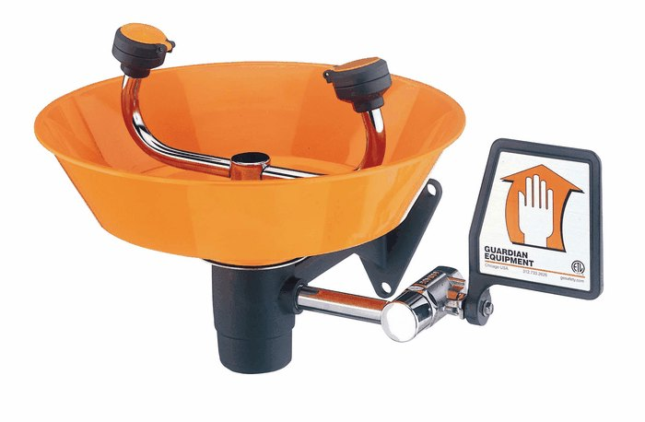


Laboratory safety

Slide 5
Lab Safety
1st Floor Lab
Closed toed shoes
Subject to change, will keep you updated
4th Floor-TRIAL Lab
Closed toed shoes
Safety Glasses (provided)
Gloves (when required)

Slide 6

Laboratory safety
Follow instructor’s directions and the written safety precautions in the lab manual

Slide 7

Laboratory procedures
You are REQUIRED to know the lab procedures before coming to the lab – Accuracy is a must!
Pre-Lab Exercise – turned in at the beginning of the lab to receive credit
Scores >3 out of 5 = 20% reduction

Slide 8
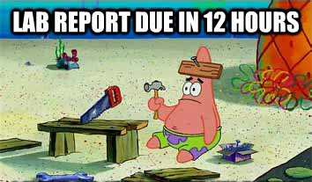
Laboratory reports
Due at the beginning of the following lab
Late reports – up to 1 week late- 50% penalty; after 1 week no credit
No make-up labs
NO LAB, NO REPORT
DO NOT SUBMIT A HANDWRITTEN LAB REPORT!!!

Slide 9


Grading system
Lab constitutes 25% of your semester grade
Weekly lab reports 235 pts
Pre-Lab Exercises 60 pts
Lab Final 75 pts
300 pts

Slide 10
Academic Dishonesty
All members of the Oklahoma State University community are entrusted with academic integrity, which encompasses the fundamental values of honesty, trust, respect, fairness, and responsibility. Therefore, you are expected to demonstrate academic integrity through the following actions:
• understand and uphold the academic integrity guidelines established by the University and the instructor.
• present your own work for evaluation by your instructors.
• appropriately cite the words and ideas of others.
• protect your work from misuse.
• accept responsibility for your own actions.
• treat instructors and members of the Academic Integrity Panel with respect when violations of academic integrity are examined or appealed.
• trust instructors and members of the Academic Integrity Panel to enforce the academic integrity policy and procedures.

Slide 11
Laboratory Schedule
Date | Lab # | Lab Topic | Lab report Point Value
Aug. 21 | 1 | Lab Orientation and Chemistry Review | 15
28 | 2 | In-field soil sampling | 10
Sept. 4 | 3 | Nutrient leaching and mobility | 20
11 | 4 | Cation exchange capacity | 20
18 | 5 | pH and lime requirement | 15
25 | 6 | EC, ESP, and SAR (saline/sodic soil tests) | 20
Oct. 2 | 7 | Carbon, nitrogen, and organic matter | 20
9 | 8 | Soil test for nitrogen | 15
16 | 9 | Soil test for phosphorus | 20
23 | 10 | Soil test for potassium, sulfur, and SWFAL tour | 20
30 | 11 | Fertilizer calculations | 20
Nov. 6 |  | No Lab
13 | 12 | In-field precision agriculture | 15
20 | 13 | Micronutrient deficiencies | 10
27 |  | No Lab
Dec. 5 |  | Lab Final | 80

Slide 12
Laboratory Schedule
Date | Lab # | Lab Topic | Lab report Point Value
Aug. 21 | 1 | Lab Orientation and Chemistry Review | 15
28 | 2 | In-field soil sampling | 10
Sept. 4 | 3 | ? | ?
11 | 4 | ? | ?
18 | 5 | ? | ?
25 | 6 | ? | ?
Oct. 2 | 7 | ? | ?
9 | 8 | ? | ?
16 | 9 | ? | ?
23 | 10 | ? | ?
30 | 11 | Fertilizer calculations | 20
Nov. 6 |  | No Lab
13 | 12 | In-field precision agriculture | 15
20 | 13 | Micronutrient deficiencies | 10
27 |  | No Lab
Dec. 5 |  | Lab Final | 80
ALL SUBJECT TO CHANGE/IT WILL CHANGE

Slide 13
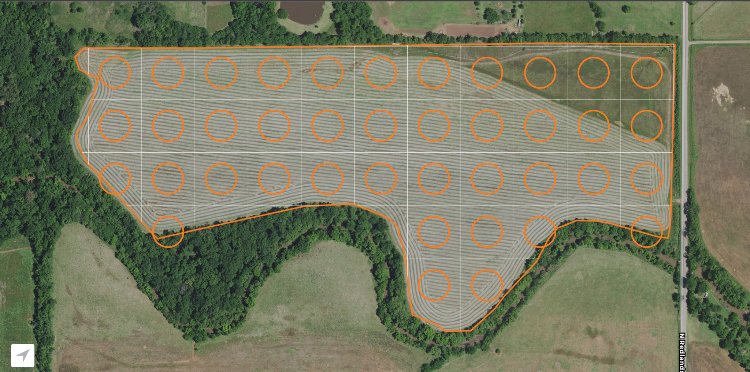
1
2
3
4
5
6
7
8
9
10
11
12
13
14
15
16
17
18
19
20
21
22
23
24
26
27
28
29
30
31
32
33
34
25
36
37
38
35
39
40

Slide 14



Chemistry Review Exercise
SOIL 4234 Laboratory No. 1

Slide 16
Binary compounds
The cation is always named first and the anion second
A simple cation (obtained from a single atom) takes its name from the name of the element
A simple anion is named by taking the first part of the element name (the root) and adding –ide.
Example: NaCl sodium chloride
KBr potassium bromide
MgS

Slide 17
Nomenclature of Compounds
For cations having two valence states, the higher valence is ic and the lower valence is ous
Example: Cu₂O: copper (I) oxide - cuprous oxide
CuO: copper (II) oxide – cupric oxide

Slide 18
Ternary compounds
Contains 3 elements
Two elements together form an anion
Suffixes ite and ate
“ite” – element not in its highest valence
“ate” – element in its highest valence
Example: SO₄⁻: sulfite
SO₄²⁻: sulfate

Slide 19
Chemical formula
Xª + Y^{b} X_{b}Y_{a}
Na¹⁺ + Cl¹⁻ Na₁Cl₁ NaCl
Al³⁺ + Cl¹⁻ AlCl₃
Al³⁺ + SO₄²⁻ Al₂(SO4)₃

Slide 20
Molecular weight (1)
MgCl Mg = 24.3 g
Cl = 35.5 g
59.8 g
Fe₂0₃ Fe = 55.8 (2) = 111.6 g
O = 16.0 (3) = 48.0 g
159.6 g
Na₂SO₄ Na = 23.0 (2) = 46.0 g
S = 32.1 = 32.1 g
O = 16.0 (4) = 64.0 g
142.1 g

Slide 21
Equivalent weight (1)
Equivalent weight = molecular weight
valence
Equivalent acid or base: Amount of that acid or base that can furnish 1 mole or H⁺ or OH⁻ ions.
CaCO₃ CO₃²⁻ can furnish 2 H⁺
have a valence of 2

Slide 22
Percent material (2)
Percent material = element molecular weight
total cmpd molecular weight
X 100
Percent H in H₂SO₄
H = 1(2) = 2 (2/98)*100 = 2%
S = 32(1) = 32
O = 16 (4) = 64
98

Slide 23
Number of ions in an acre (3)
(Weight/acre) x (1mol element/molecular weight of element) x (Avogadro’s constant)
Avogadro’s constant = 6.02 x 10²³
number of units in one mole of any substance (defined as its molecular weight in grams). The units may be electrons, atoms, ions, or molecules, depending on the nature of the substance and the character of the reaction (if any).

Slide 24
pH average (5)
Step1: -log (H⁺) = 6.2
Calculator: invlog(-6.2)
negative sign
Step 2: Average = total/no. of items
Step 3: pH = -log average

Slide 25
No. 6
Step 1. Convert µmol P to g P
g soil g soil
Step 2. Find weight of P/ac
1 acre = 955,338,040 g soil
2,104,269 ~ 2,000,000 lbs soil

Slide 26
Titration
Step 1. Determine the no. of moles of titrant
Step 2. Determine the ratio of titrant and titrand
Step 3. Determine the no. of moles of titrand
Step 4. Determine the molarity of titrand

Slide 27
No. of grams compound (8)
ppm = mg/L = 10⁻³g/L
gram x mole element x mole cmpd x g cmpd
L gram element mole element mol cmpd

Slide 28
Calculating no. of g for a solution (9)
M = mol/L
mol x mole cmpd x g cmpd
L mole element mol cmpd

Slide 29
Oxidation state
RULES
The oxidation state of an element by itself is 0
Hydrogen is always 1⁺ (except LiH₃ and AlH₃)
Oxygen is always 2- (except H₂PO₂)

