Slide 1
Soil Extractable Plant Nutrients
Introduction
Seventeen essential nutrients
C, H and O – Photosynthesis
All remaining are absorbed by plant roots (soil)
If insufficient, can limit or end plant growth, decrease yield, lower profits…
If excessive, may limit or end plant development, decrease profits and increase environment risks

Slide 2
Soil Extractable Plant Nutrients
Introduction
Human management in agriculture
High yields
Harvest grains and/or biomass – removal
Supplemental nutrients may be required for optimize growth – high yields

Slide 3
Soil Extractable Plant Nutrients
Phosphorus
Enables plants to convert solar energy into chemical
Immobile in the soil
Deficiencies in early season (small roots, low soil pH, soil temperature…)
P fertilizers react with Fe, Al, Ca
Total soil P much lower than plant available
Extractant is necessary

Slide 4
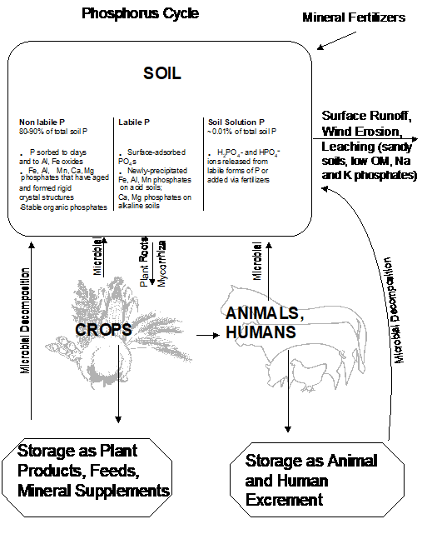
Soil Extractable Plant Nutrients
Phosphorus

Slide 5
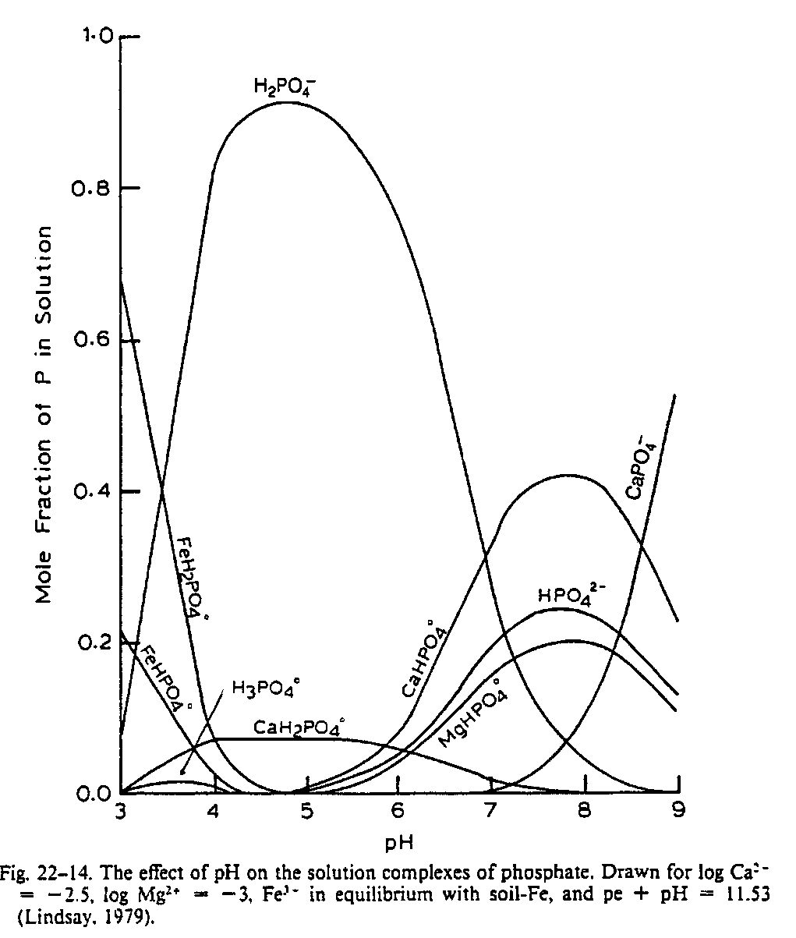
Soil Extractable Plant Nutrients
Phosphorus

Slide 6
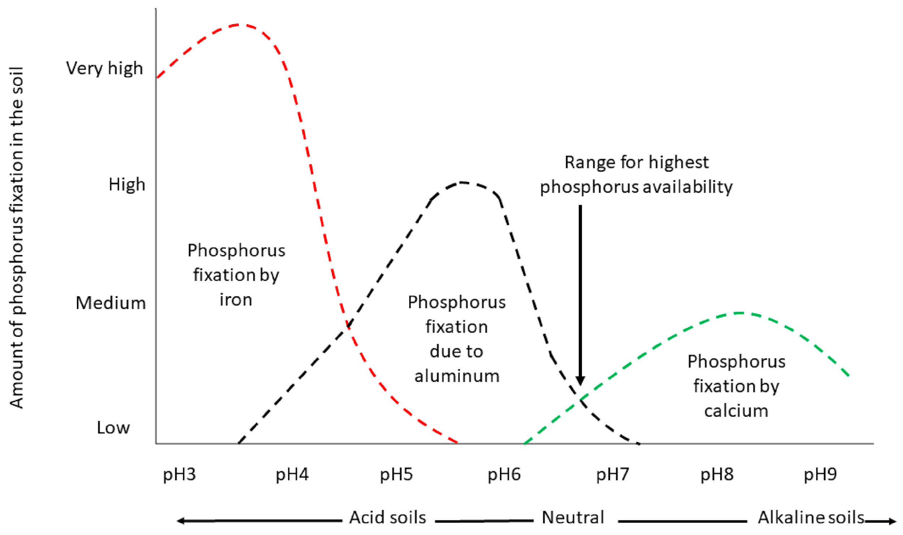
Soil Extractable Plant Nutrients
Phosphorus

Slide 7
Soil Extractable Plant Nutrients
Phosphorus extractors
Dilute solutions of strong acids such as H2SO4, HCl and HNO3 which are effective in extracting Ca-P, Fe-P and Al-P in acid and neutral soils (Mehlichs 1).
Dilute solutions of strong acids plus a complexing ion such as NH4F, which are most effective in acid and neutral soils (Bray P1, Mehlich 3).
Dilute concentrations of weak acids such as citric or acetic acid which are effective in extracting Ca-P and will also complex the Al ion facilitating the extraction of Al-P (Lancaster's Extractant).
Buffered Alkaline Solutions such as NaHCO3 which have been most effective in predicting available P on calcareous soils high in Ca-P (Olsen's).

Slide 8
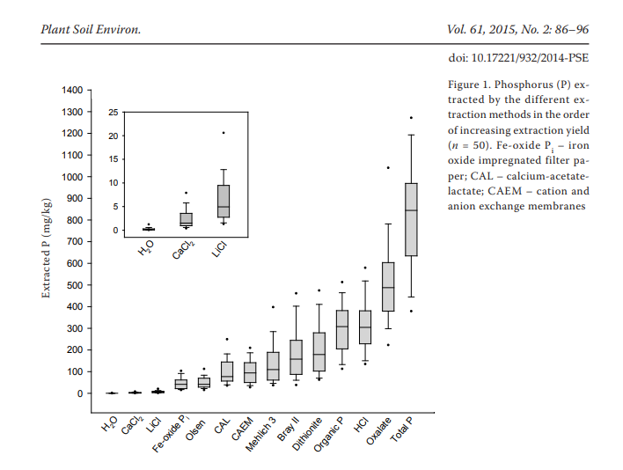
Soil Extractable Plant Nutrients
Phosphorus extractors

Slide 9
Soil Extractable Plant Nutrients
Phosphorus extractors
What soil extractant should we use?
It depends…

Slide 10
Fertilizer Recommendation
How can we recommend fertilizer by utilizing a soil extractant P values?
A lot of research!!!
Correlation – Selecting soil test (method of extraction)
Calibration – Response to applied fertilizer at any soil level
Interpolation (recommendation) -

Slide 11
Correlation
Relationship between plant uptake of a nutrient or yield and the amount of nutrient extracted by a particular soil test
Several soil types and nutrient range
Greenhouse (immobiles) and field trials (mobiles)

Slide 12
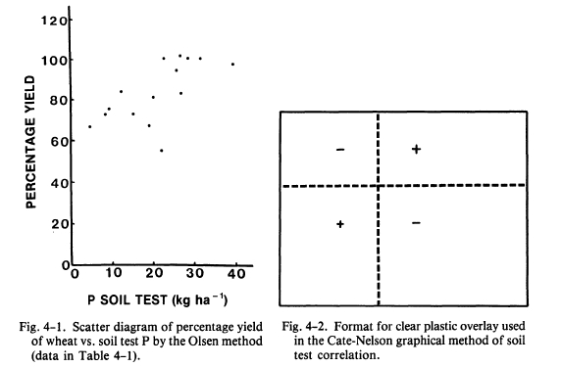
Correlation

Slide 13
Calibration
Related to crop response
Describe in a easy way to be understood
Simplify fertilizer recommendations by placing soil in categories of response

Slide 14
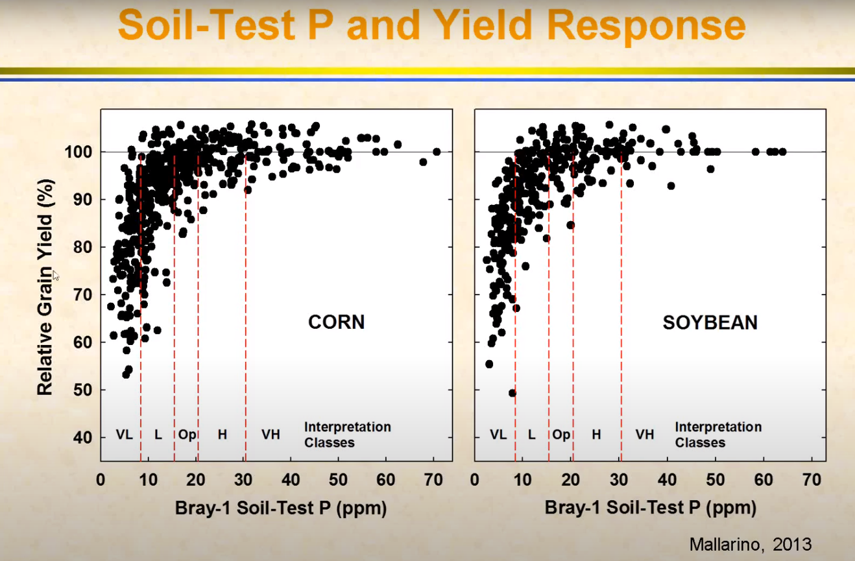
Calibration

Slide 15
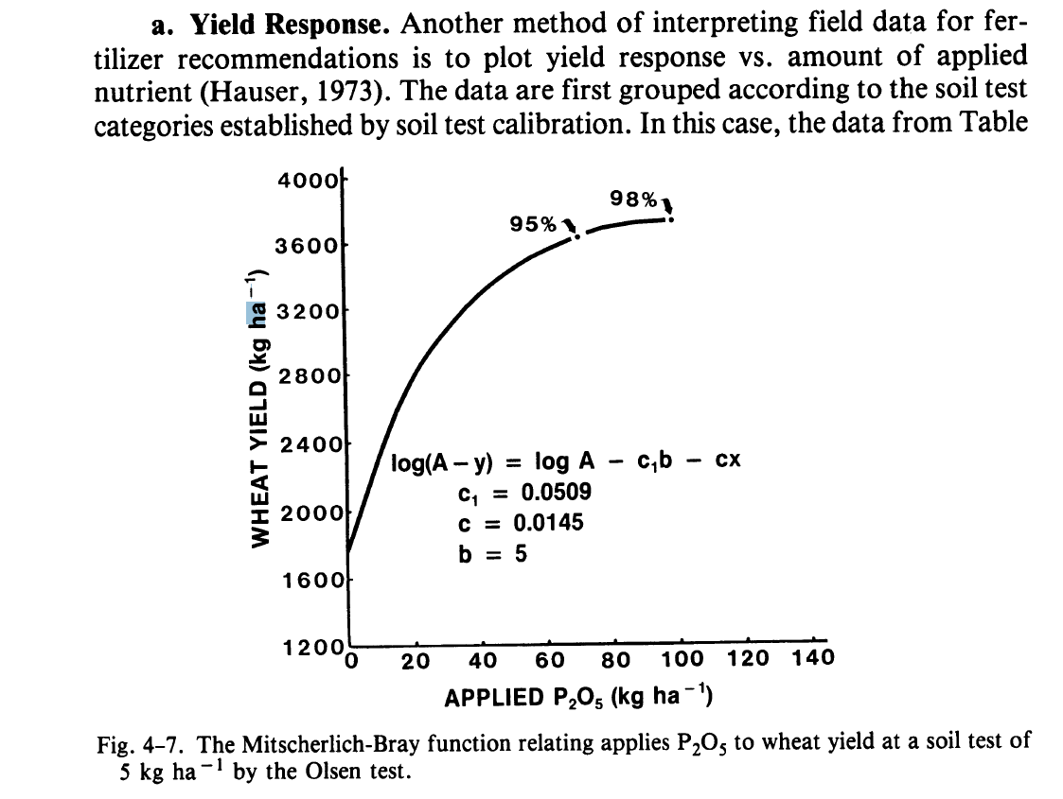
Fertilizer Recommendation

Slide 16
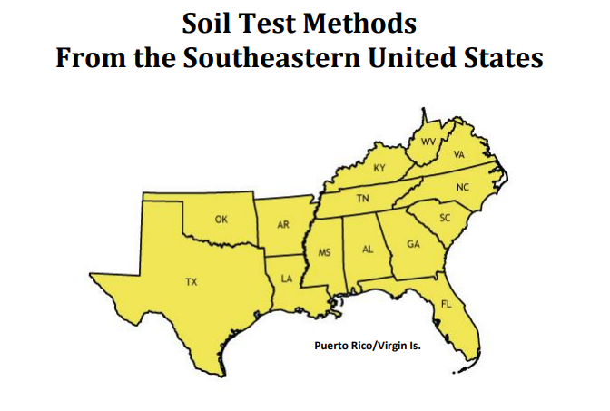
How about K?
For OKlahoma, M3 is utilized – ICP-OES

Slide 17
Mehlich 1 – 1953 – P, K, Ca, and Mg
DI water 20 L
83 ml of HCl (0.05 M) (strong acid)
14 ml of H2SO4 (0.0125) (strong acid)
pH approx. 1.2 (very acidic)
Problems – not good correlation between extracted P and plant growth
Across several soil types
M1 was not dissolving bioavailable P associated with Al – Heavy texture soils

Slide 18
Mehlich 3 – 1984 - NC
Ammonium Fluoride was added – To dissolve bioavailable P associated with Al in solution
Acetic acid was added as a pH buffer – to prevent (CaF₂) P resorbing in high pH soils
Ammonium Nitrate – NH4 – Ca, Mg, K.
EDTA (chelate) – Cu, Mn, Zn
Note about M2 – HCl and no EDTA

Slide 19
ICP – OES
Universal extractant!!!

Slide 20
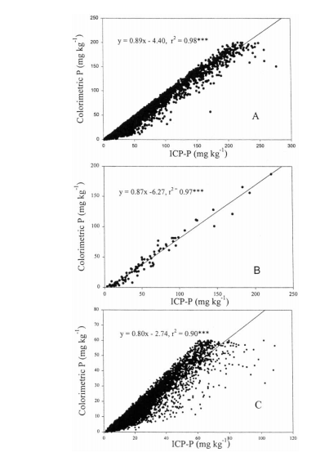
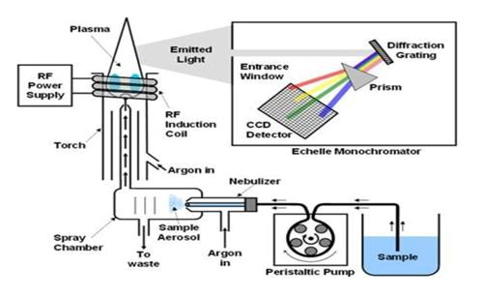
ICP – OES

Slide 21
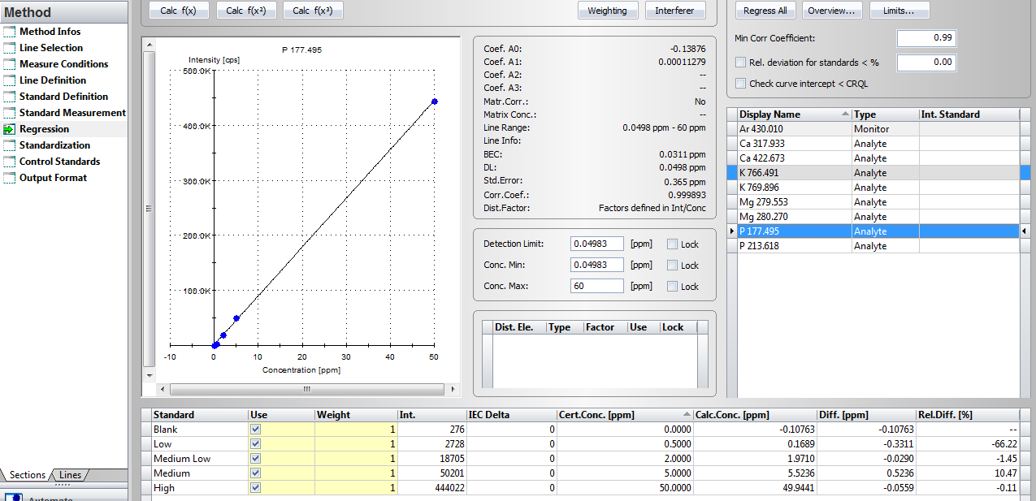
ICP – OES - Phosphorus
Y = ax + b
Intensity = (ppm x 8863.8) + 1252.2

Slide 22
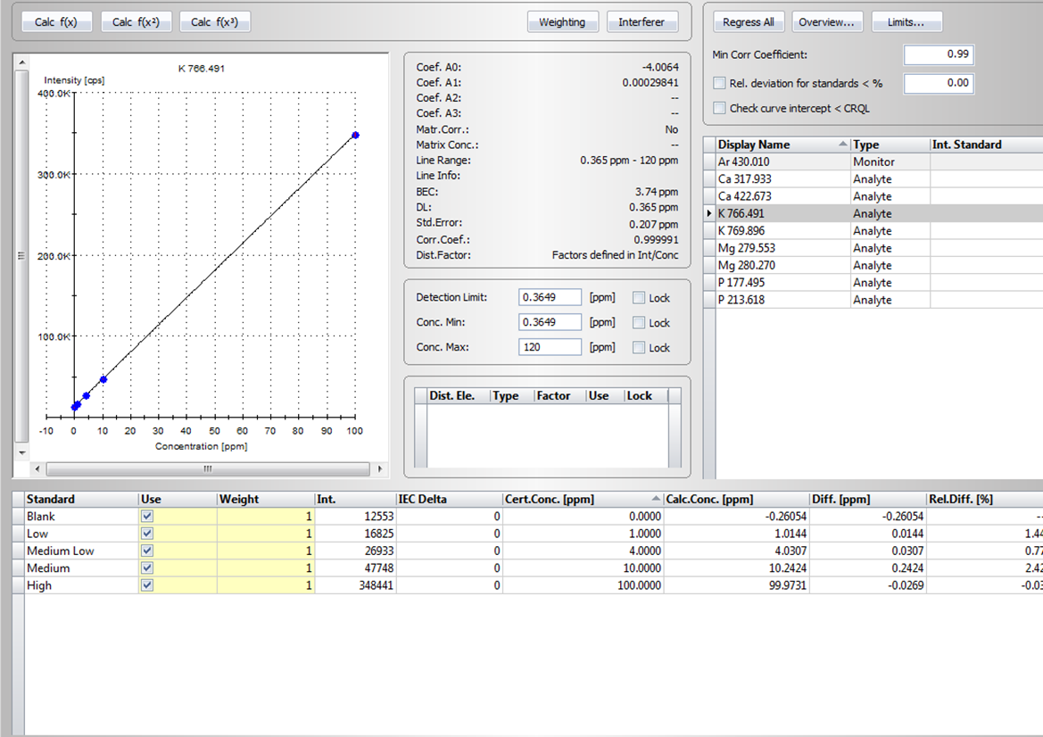
ICP – OES - Potassium
Y = ax + b
Intensity = ppm x 3351 + 13427

Slide 23
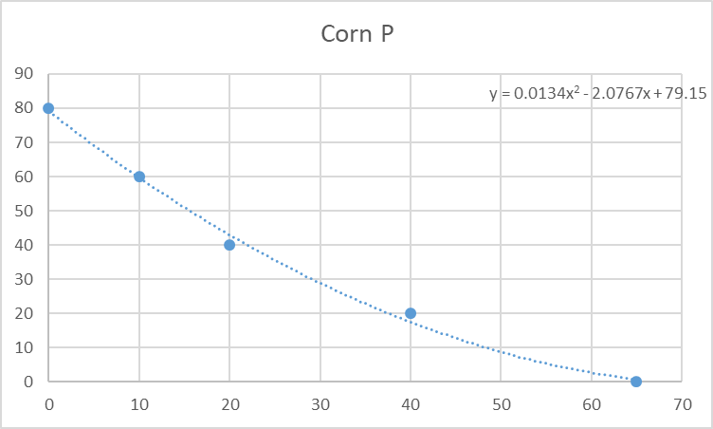
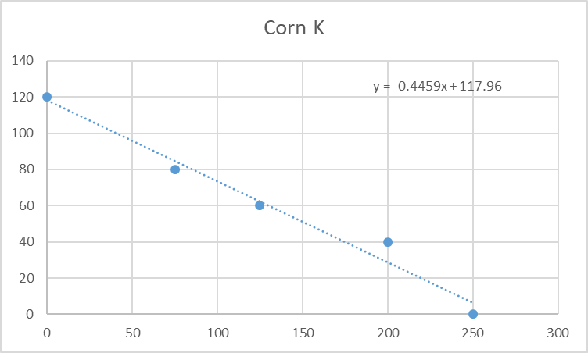
STP P needed
0 80
10 60
20 40
40 20
65 0
P Needed
STP
STK K needed
0 120
75 80
125 60
200 40
250 0
K needed
STK

