Slide 1
Identification of Micronutrient Deficiencies
SOIL 4234 Lab
Fall 2014

Slide 2
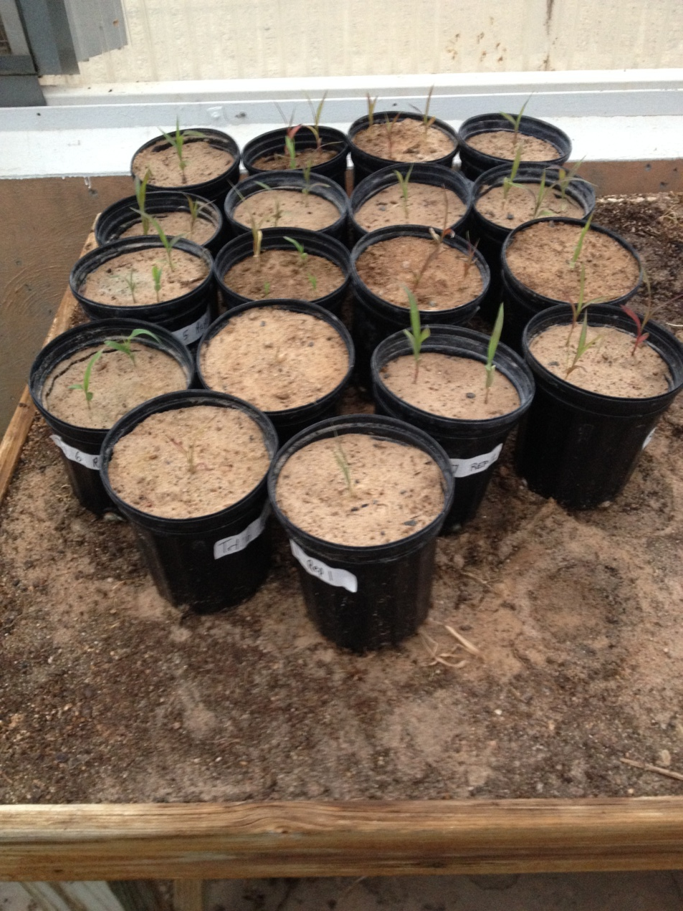
Heat Deficient Sorghum

Slide 3
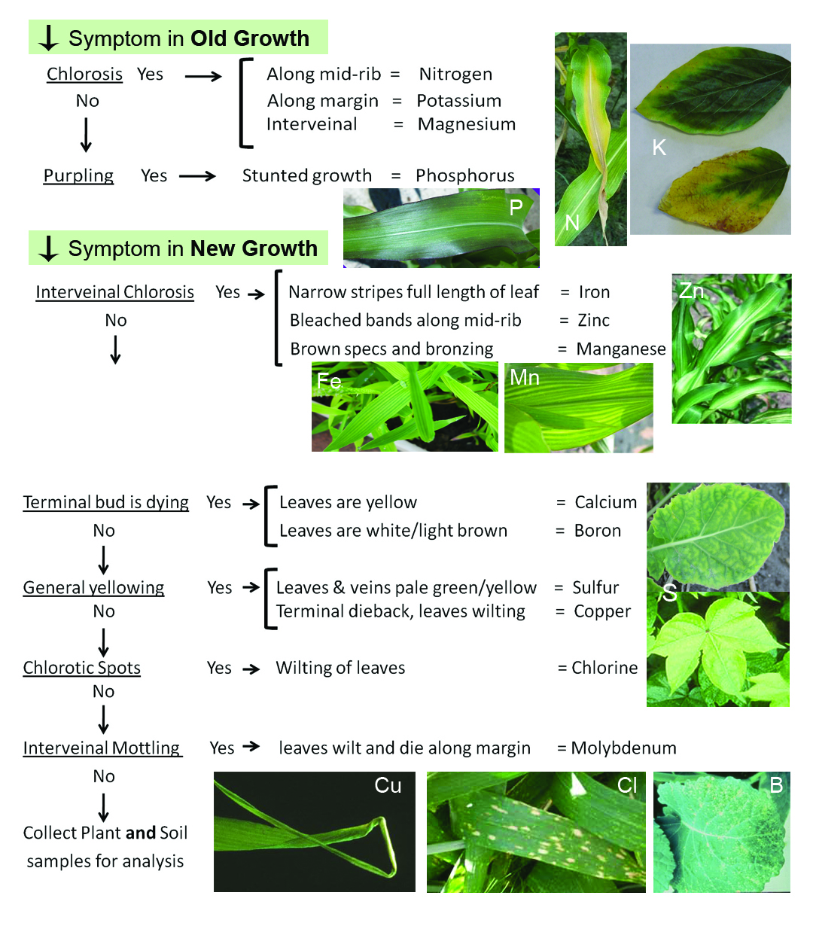
Nutrient Deficiency ID
Where
Color
Pattern
Soil
Environment

Slide 4
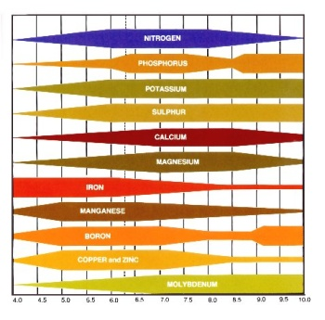

Slide 5
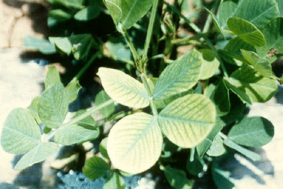
Iron Deficiency
Iron is immobile in the plant: Upper/Newer leaves Intervienal chlorosis, stripes narrower than zinc and extend full length of leaf
Calcareous Soils pH >8

Slide 6
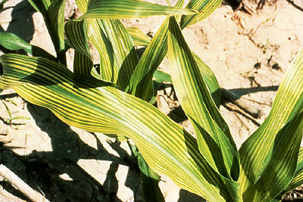
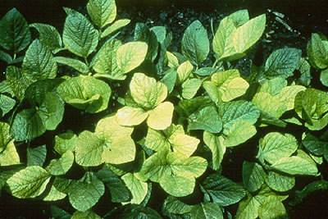
Iron Deficiency

Slide 7
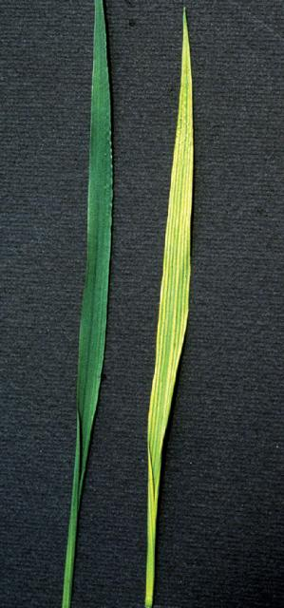
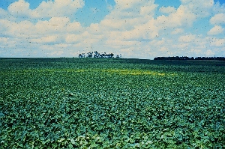
Iron Deficiency

Slide 8
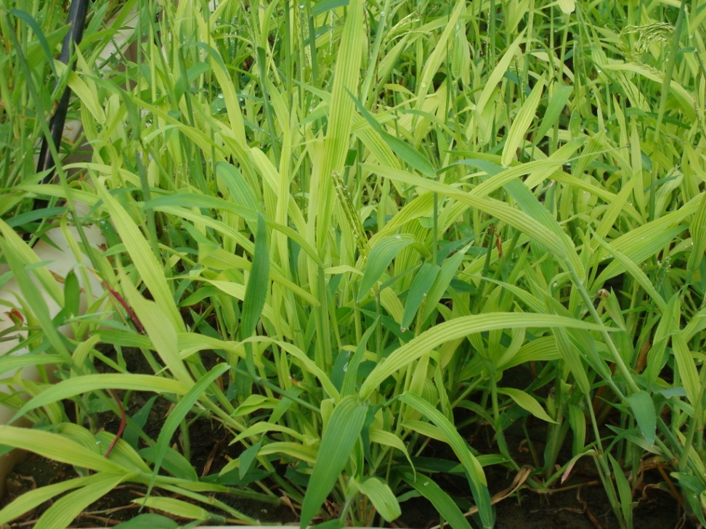
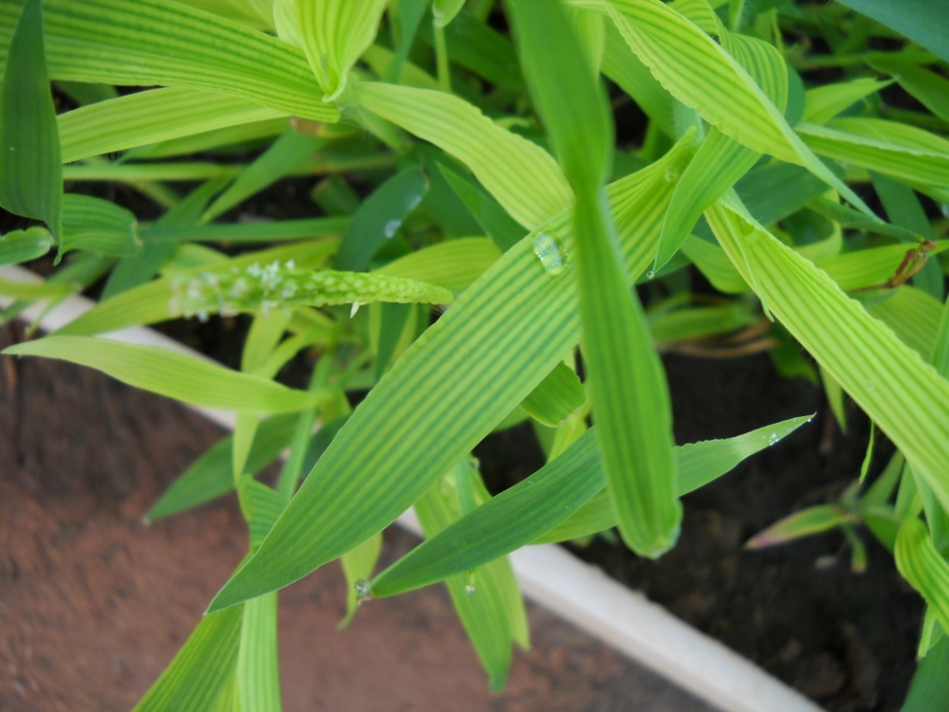
Iron Deficiency

Slide 9
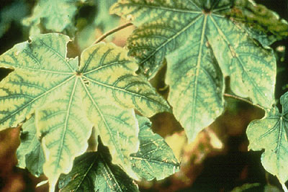
Zinc Deficiency
Zinc relatively immobile in plant: Upper/Newer leaves
Purple margins, inward purple blotching,
bleached bands on either side of midrib near base, intervienal chlorosis
Acidic, Sandy soils, Calcareous pH>8

Slide 10
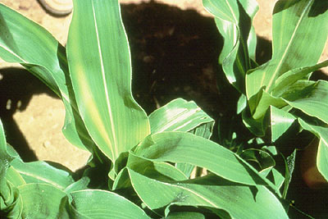
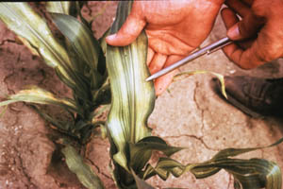
Zinc Deficiency

Slide 11
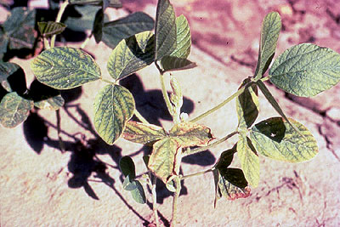
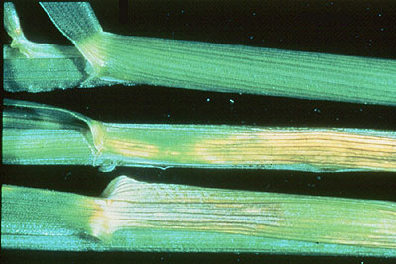
Zinc Deficiency

Slide 12
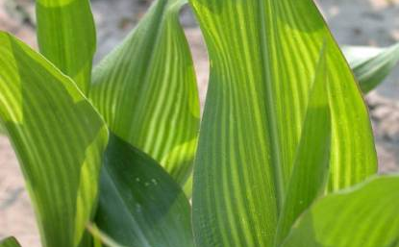
Manganese Deficiency
Manganese is relatively immobile in plant, but can move in xylem sap.
Interveinal chlorosis, very similar to Fe, Mg, N.
Severe deficiencies have brown specs and bronzing
Limited at high pH, Calcareous soils.

Slide 13
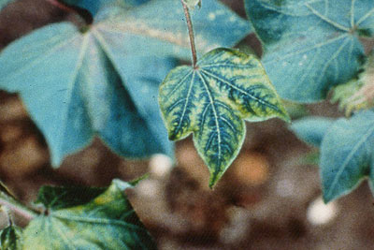
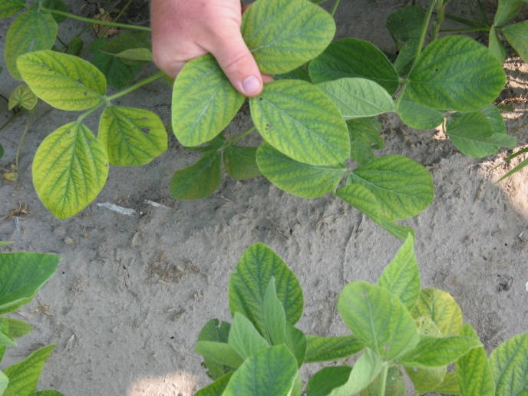
Manganese Deficiency

Slide 14
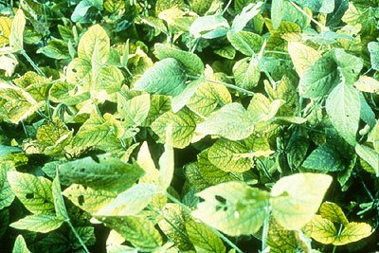
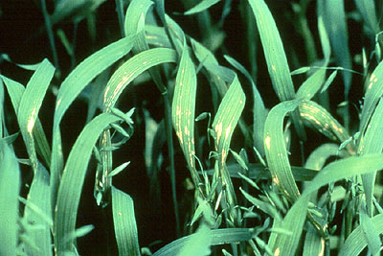
Manganese Deficiency

Slide 15
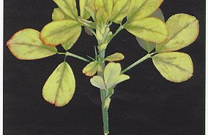
Boron Deficiency
Boron is immobile in the plant: Upper/Newer leaves
Wide range of symptoms; necrosis of young leaves and terminal buds,
reddening in some legumes and canola
Well drained sandy soils

Slide 16
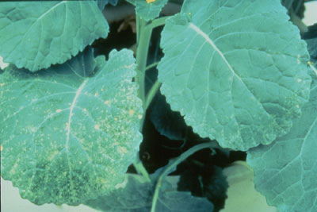
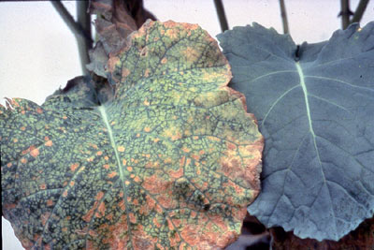
Boron Deficiency

Slide 17
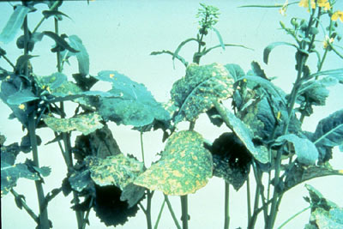
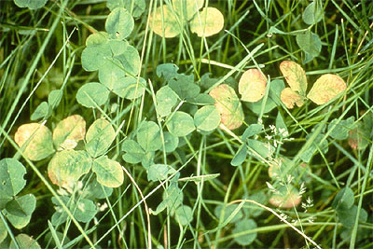
Boron Deficiency

Slide 18

Copper Deficiency
Copper is Immobile in the plant: Upper/Newer leaves
Stunted growth, terminal dieback, necrosis of meristem, delayed flowering
New leaves uniformly pale

Slide 19
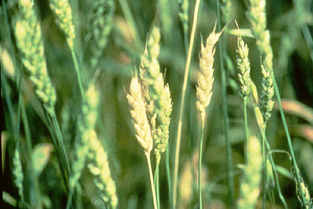
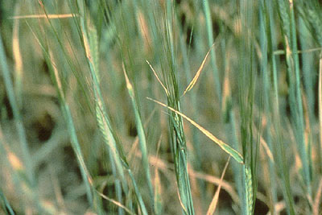
Copper Deficiency

Slide 20
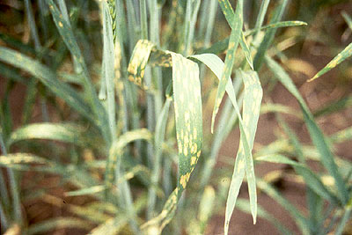
Chlorine Deficiency
Chlorine is mobile in the plant: Lower/Older leaves
Reduced growth, necrotic and chlorotic spots, bronzing in extreme.
Upper leaves will wilt.
Sandy soils

Slide 21
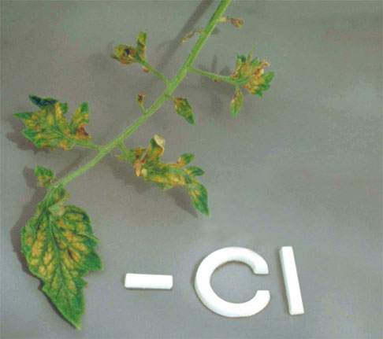

Chlorine Deficiency

Slide 22
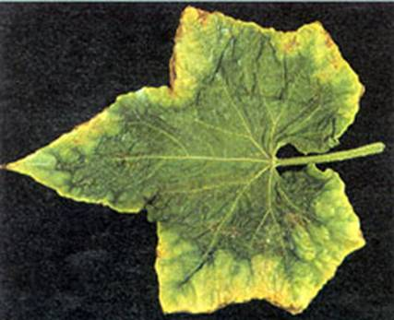
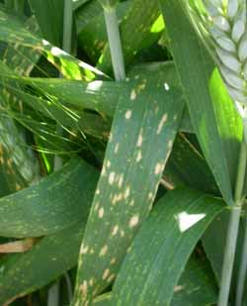
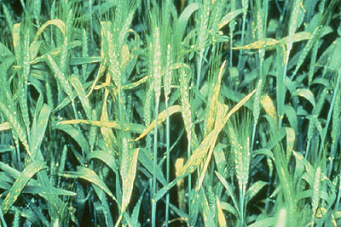
Chlorine Deficiency

Slide 23

Molybdenum Deficiency
Molybdenum is readily translocated; whole plant
Related to N metabolism, yellowing, stunting, interveinal mottling
Cupping of upper leaves
Soil with low pH and high Fe and Al.

Slide 24
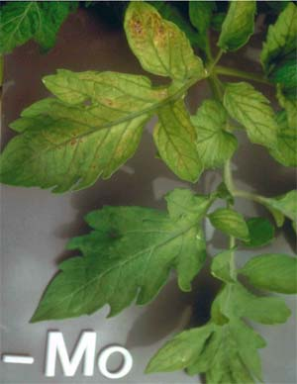

Molybdenum Deficiency

Slide 25
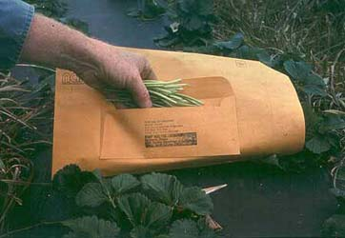
Tissue Testing
More useful for micronutrient fertilizer recommendations
Few soil testing procedures for micronutrients
Measuring in ppm where as macros are measured as percent (parts per hundred)
Popularity increasing
SWFAL does perform
commercially
www.ncagr.gov

Slide 26
Sufficiency Threshold Values

Slide 27
Proper Sampling Techniques
Representative of the field
Sample troubled area and an equal sized area of normal plants
Crop | Plant part to sample | Stage of growth | Number of plants
Soybean | All above-ground | Seedling stage (less than 12") | 20-30
Soybean | Top fully developed trifoliate leaves | Prior to or during initial flowering* | 20-30

