Slide 1
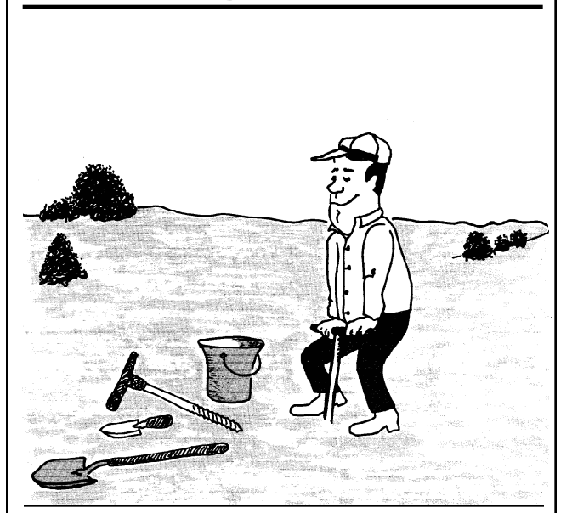
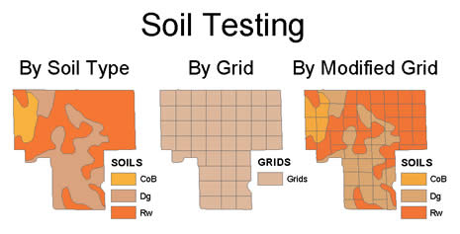
In-Field Soil Sampling
SOIL 4234 Laboratory No. 2

Slide 2
Soil Testing
A Soil Test is a process by which nutrients are chemically removed from the soil and measured for their plant available content within the sample. The quantity of available nutrients in the sample determines the amount of fertilizers needed for a particular crop. A soil test also measures pH and the amount of acidity within the soil to determine if lime is needed and how much should be applied.

Slide 3
How often should a soil be tested?
A soil test should be conducted if fertilizer is going to be applied or when problems occur during the growing season.
Once every year is recommended when N fertilizer is applied, and at least once every three years if P and K are concerned.

Slide 4
When to sample?
Anytime throughout the year for checking pH, P and K.
Collect soil samples 1-2 months before planting.
Early spring is a good time to take soil samples for summer crops, and summer is a good time to sample for fall and winter crops. This allows time for lime recommended to react with the soil and change the pH before the crop is planted.
To assess soil available N, sample as close to planting as possible.
DO NOT SAMPLE immediately after lime, fertilizer, or manure application

Slide 5
Soil sampling techniques
Remember that a GOOD soil sample is obtained by sampling a UNIFORM field area
Random sampling
Stratified random sampling
Grid sampling

Slide 6
Random Sampling
Random sampling involves randomly and independently sampling the entire field and composite the sample.

Slide 7
Stratified Random Sampling
Farms or fields are sampled according to soil areas. Different histories of crop management require separate samples even on the same soil. Eroded areas or other poor yielding spots must be sampled and evaluated separately. Samples have to be taken from each soil and crop sequence.
A field or plot, is divided into sub-populations (strata). For example, the strata may be a ridge, a slope, a low area or a level area.
A simple random sample is taken from each strata.

Slide 8
Stratified Random Sampling

Slide 9
Why stratified random sampling
Make a statement about the sub-population
Increase the accuracy of estimates over the entire population
Since the sampler selects stratified random sampling for its accuracy, stratification must eliminate some variations caused by any sampling errors. In general, accuracy increases as stratification becomes more well defined.

Slide 10
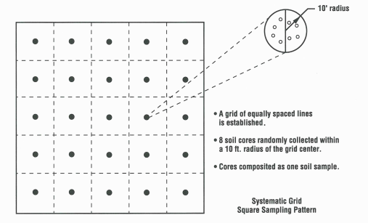
Grid sampling
Grid (systematic) sampling uses geo-referenced fixed points and each grid is sampled and treated individually.
Notes:
The common approach to achieve systematic soil sampling is to overlay a square or rectangular grid on a map or photograph of the field, identify and drive to the middle of each grid cell, and collect a soil sample at that point

Slide 11
Grid sampling
Advantages:
Ensures a high degree of representativeness, allows layering of data, allocates nutrients where they are needed
Disadvantage:
Expensive – both to collect and to analyze

Slide 12
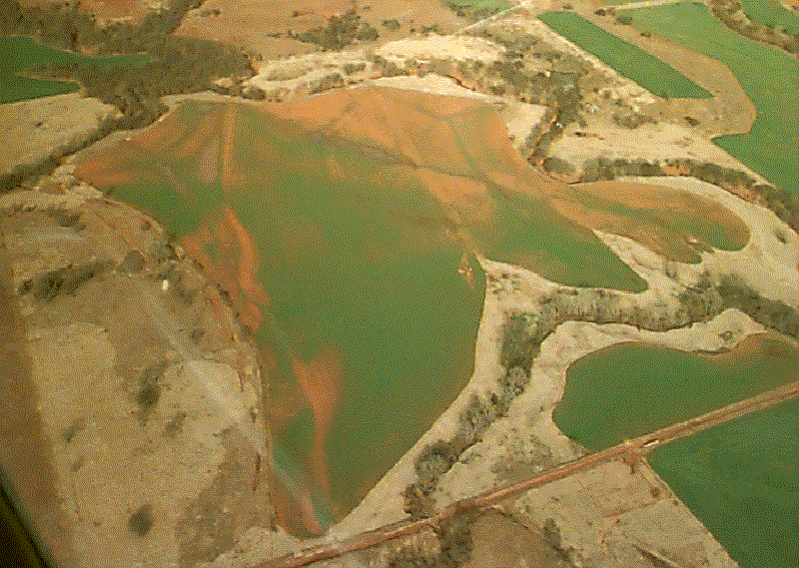
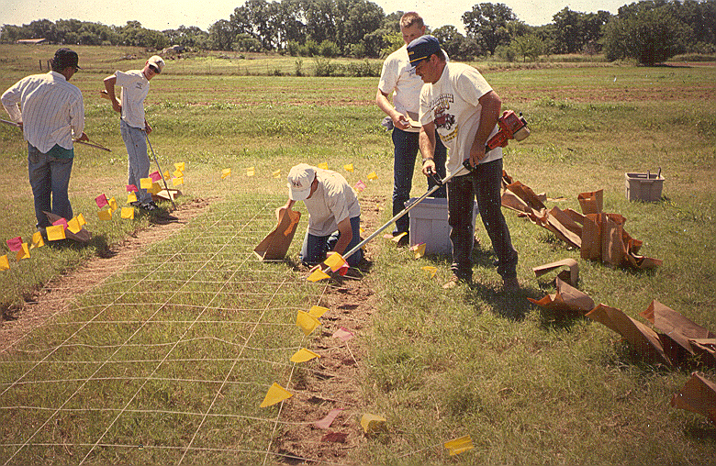
Spatial variability

Slide 13
In-Field Soil Sampling
SOIL 4234 Laboratory No. 2

Slide 14
Objectives
Learn how to collect a representative soil sample as a guide to nutrient management.
Understand variability in field scale fertilizer requirements between random sampling and grid sampling techniques

Slide 16
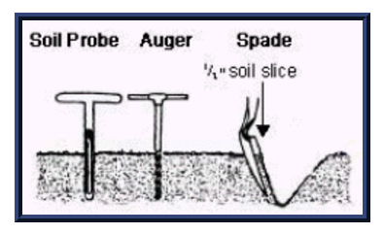
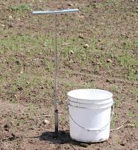
Tools and supplies
A clean plastic bucket, a soil probe or a shovel are needed.
One pint is usually adequate for all tests

Slide 17
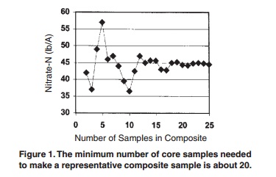
Soil Sampling: HOW?
Minimum of 20 cores

Slide 18
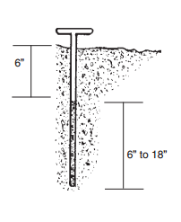
Soil Sampling: HOW?
Proper depth
Cultivated fields
Tillage depth, 6 inches
Deep-rooted non-leguminous crop – additional soil sample from 6 – 18 inches
Non-cultivated fields
six inches
Nutrient loss in run-off – sample two inches depth

Slide 19
Soil Samples: Submit where?
Send soil samples to:
OSU Soil, Water and Forage Analytical Laboratory

Slide 20
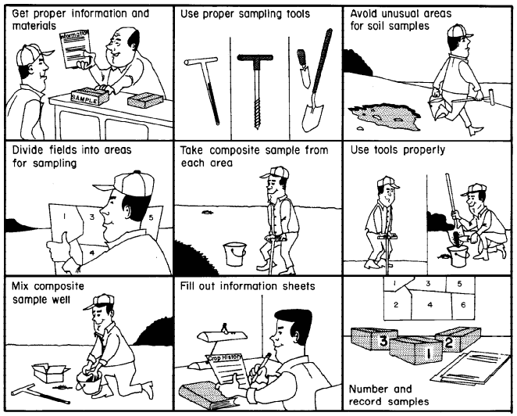

Slide 21
Report
Due September 14th
Submit: Introduction, Tables 1 and 2, and answers to questions

Slide 22
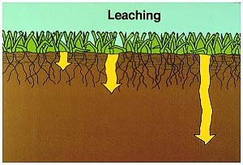
Nutrient Mobility in Soil
SOIL 4234 Laboratory No. 3

Slide 23
Mobility of nutrients within the soil
Mobility of nutrients within the soil is closely related to the chemical properties of the soil, i.e. CEC and AEC as well as moisture
Cation exchange capacity (CEC) is the total capacity of a soil to hold exchangeable cations. CEC is an inherent soil characteristic and is difficult to alter significantly.
Monovalent nutrient ions have a good chance of being mobile in soils.
Monovalent anions, Cl⁻ and NO₃⁻, are mobile in the soil because they are not adsorbed on ion exchange sites.

Slide 24
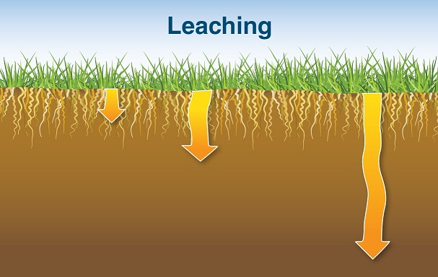
Mobility of nutrients within the soil
Mobility of nutrients within the soil is closely related to the chemical properties of the soil, i.e. CEC and AEC as well as moisture
Sufficient moisture leaching
Leaching – downward movement of fertilizers through the soil with percolating water

Slide 25
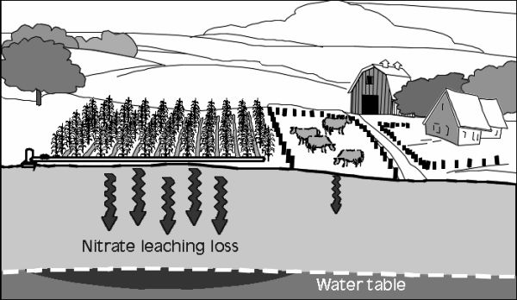
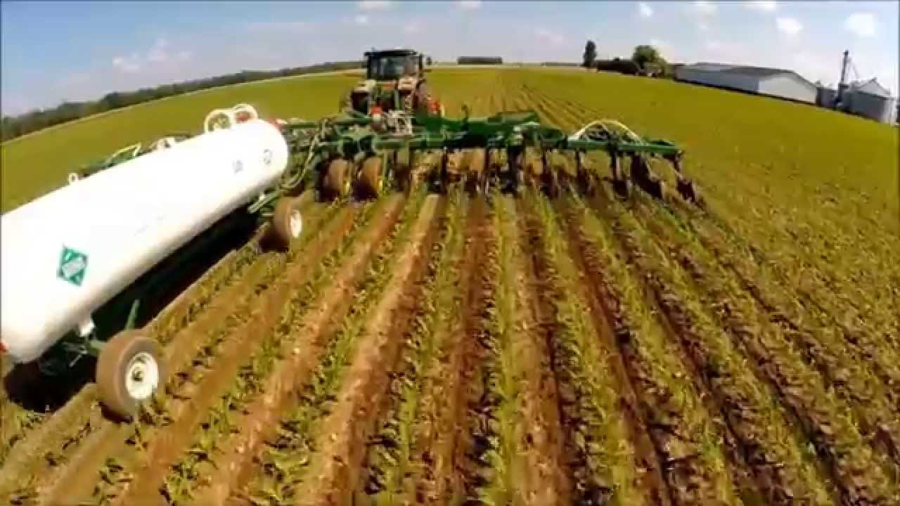
Impacts of leaching nutrients
Environment – groundwater contamination
Agriculture -fertilization

Slide 26
Objectives
Calculate the relative mobility of nitrogen (NH₄⁺ and NO₃⁻), phosphorus (H₂PO₄⁻, and HPO₄²⁻), and potassium (K⁺) when applied to the soil surface of a cultivated field.
Calculate the percentage of fertilizer added that has leached into the subsoil.
Understand in which soil types and soil conditions nutrient mobility and leaching are of greatest and least concern.

Slide 27
Procedure
Fertilizer application (in solution)
500lbs ac⁻¹ of total N, available P₂O₅, and soluble K₂O
Solution volume: equivalent to 2” irrigation plus 9” 1 WAA
Soil sampling: surface (0-6”) and sub-surface (6-18’); 2 weeks after initial application
Analyzed for plant available and water soluble forms of nutrients

Slide 28
Procedure
Trmt | Nutrient | Fertilizer Source | Analysis
1 | Control | None | NH₄-N, NO₃-N, P, and K
2 | Nitrogen | Urea | NH₄-N and NO₃-N
3 | Phosphorus | Monocalcium Phosphate | P
4 | Potassium | Potassium Chloride | K
5 | Nitrogen | Urea + NutriSphere-N® | NO₃-N

Slide 29
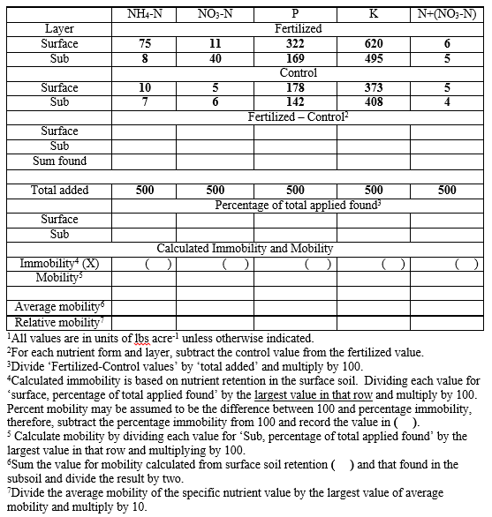
Nutrient Mobility

Slide 30
Nutrient Mobility

Slide 31
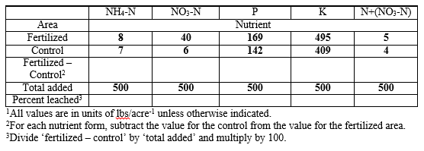
Leaching

Slide 32
Report
Introduction
Tables 2 and 3 (filled)
Answers to questions

