Slide 1
Lab 3 Soil pH
SOIL 4234

Slide 2
What is Soil pH?
pH refers to the negative logarithm of the hydronium (H⁺) concentration in soil solution, relating to the OH⁻ concentration
pH = -log[H⁺]
“p” is the log
“H” is the concentration of H⁺
pH and pOH are interconnected
Just like NaCl becomes Na⁺ and Cl⁻ when in solution, H₂O will become H⁺ and OH⁻ when in solution
For any solution at room temperature:
pH + pOH = 14

Slide 3
What is Soil pH?
Acidic solution
H⁺ > OH⁻
Neutral Solution
H⁺ = OH⁻
Basic Solution
H⁺ < OH⁻

Slide 4
What is Soil pH?
pH = -log[H⁺]
[H⁺] = 10⁻¹ pH = 1 (strong acid)
[H⁺] = 10⁻⁷ pH = 7 (neutral)
[H⁺] = 10⁻¹⁴ pH = 14 (strong alkaline)

Slide 5
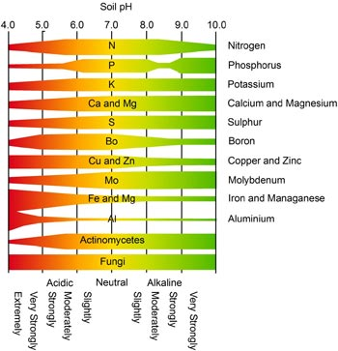
Effects on soil pH
Soil pH can affect the reactions found within the soil
Acids, specifically the H⁺ that makes a solution acidic, can cause mayhem within compounds, stripping them of their components
This not only affects nutrient availability, but also the form in which the nutrient is found in the soil

Slide 6
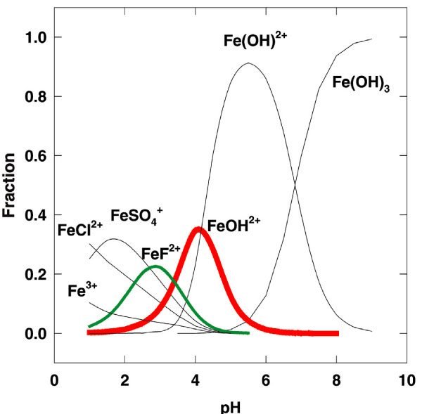
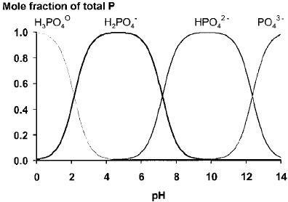
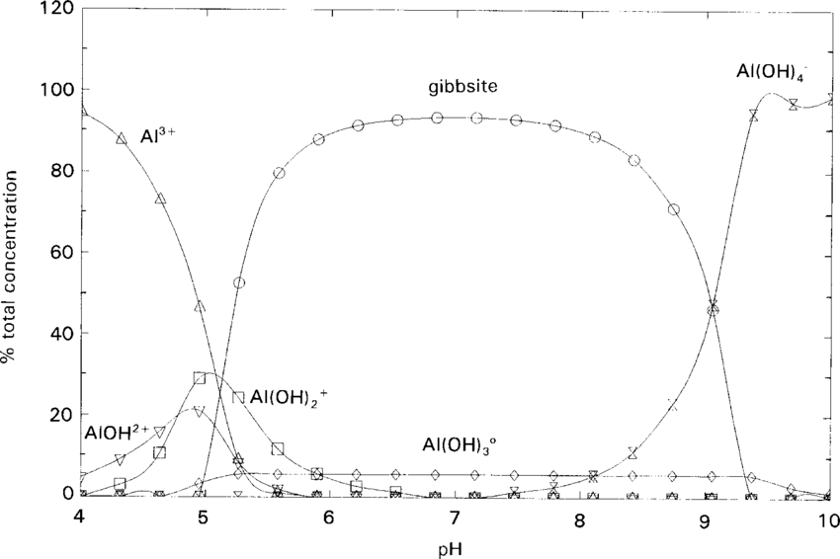

Slide 7
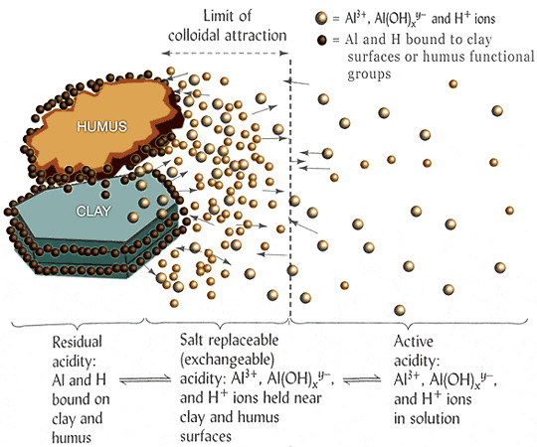
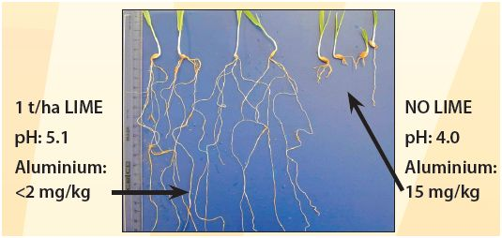
Types of Soil acidity
As with nutrients (as lecture will discuss later), there are different types of soil acidity:
Active acidity
H⁺ ions currently present in soil solution
This is what is read using a pH meter, and governs all reactions, and causes problems with soil roots
Residual acidity
All acid cations tightly bound to soil minerals.

Slide 8
Types of Soil Acidity
Exchangeable acidity
Acid cations occupied on CEC
Cation Exchange Capacity
What we discuss as buffer capacity
Buffer’s must be used to measure this type of acidity
Most common is Sikora
Larger amounts of exchangeable acidity mean that in order to enact pH change via lime, more lime will be required compared to lower exchangeable acidity

Slide 9
Origins of Acidity
Normal release of H⁺ from natural chemical processes
Atmospheric CO₂ and H₂O react to form carbonic acid
Organic molecules react with water and cause acid dissociation
Oxidation of Nutrients
Accumulation of O.M.
Reaction of Al. cations with water
Natural Deposition
Lightning deposits acidic HNO₃
Human Factors

Slide 10
Human Factors influencing soil pH
Lime required to neutralize the soil acidity produced by fertilizers if all ammonium-N is converted to nitrate-N.
Nitrogen source | Chemical Formula | Composition | Lime required (lb CaCO₃ / lb N)
Anhydrous ammonia | NH₃ | 82-0-0 | 1.8
Urea | (NH₂) ₂ CO | 46-0-0 | 1.8
Urea-Ammonium Nitrate (UAN) | (NH₂) ₂ CO, NH₄NO₃ | 28-0-0 | 1.8
Ammonium nitrate | NH₄ NO₃ | 34-0-0 | 1.8
Ammonium sulfate | (NH₄) ₂SO₄ | 21-0-0-24 | 5.4
Monoammonium phosphate | NH₄H₂PO₄ | 10-52-0 | 5.4
Diammonium phosphate | (NH₄) ₂HPO₄ | 18-46-0 | 3.6
Triple super phosphate | P₂O₅ | 0-46-0 | 0.0
Adapted from Havlin et al., 1999.
Long term application of acidifying fertilizers
Harvest of crops
 | Ca | K | Mg | Na | Total
Pounds ECCE Lime for a 30 bu/ac Wheat Crop
Grain | 2 | 10 | 10 | 2 | 24
Straw | 11 | 45 | 14 | 9 | 79
Total | 13 | 55 | 24 | 11 | 103

Slide 11
Human Factors influencing soil pH
Lime required to neutralize the soil acidity produced by fertilizers if all ammonium-N is converted to nitrate-N.
Nitrogen source | Chemical Formula | Composition | Lime required (lb CaCO₃ / lb N)
Anhydrous ammonia | NH₃ | 82-0-0 | 1.8
Urea | (NH₂) ₂ CO | 46-0-0 | 1.8
Urea-Ammonium Nitrate (UAN) | (NH₂) ₂ CO, NH₄NO₃ | 28-0-0 | 1.8
Ammonium nitrate | NH₄ NO₃ | 34-0-0 | 1.8
Ammonium sulfate | (NH₄) ₂SO₄ | 21-0-0-24 | 5.4
Monoammonium phosphate | NH₄H₂PO₄ | 10-52-0 | 5.4
Diammonium phosphate | (NH₄) ₂HPO₄ | 18-46-0 | 3.6
Triple super phosphate | P₂O₅ | 0-46-0 | 0.0
Adapted from Havlin et al., 1999.
Ammoniacal Fertilizer
Plants must uptake N in the form of NO₃⁻
Molecules will become free ions, just as Na⁺ and Cl⁻ do when in solution
In order for NH₄⁺ to be converted to a usable form, oxidation must occur
Oxidation is the movement of electrons
In this case, from the O₂ to the NH₄

Slide 12
Nitrification from NH₄⁺ to NO₃⁻

Slide 13
How do we correct soil pH?

Slide 14
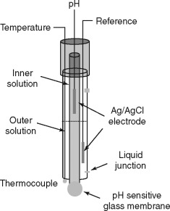
How to measure soil pH?
Using Glass electrode pH meter
Compares voltage from electrode in sample to the electrode reading coming from a reference solution, and calculates pH
Most of today’s pH meters self contain both electrodes, however not all do
Measures 2 types of acidity
Based upon the extractor used

Slide 15
How to measure soil pH?
1:1 soil:water solution
This gives you a read of solution acidity
While important information, when it comes to lime recommendations, does not give an accurate portrayal of reserve acidity in the soil
Sikora Buffer
Utilizes a base to strip the exchangeable H⁺ ions, those ions that contribute to CEC (as we’ll talk about in another lab)
pH is then read again using glass bulb electrode to give a measure of exchangeable acidity, or ‘buffer’

