Slide 1
Nutrient Mobility and CEC
SOIL 4234 Lab #4

Slide 3
Mobility of nutrients within the soil
Mobility of nutrients within the soil is closely related to the physical and chemical properties of the soil, i.e. CEC,AEC as well as moisture
In Oklahoma net soil charge is negative thus it absorb cations and repel anions
Negatively charged ions are mobile and cations are immobile

Slide 4
Cation Exchange Capacity
Measure of the capacity of the soil to hold positively charged ions (cations) at a given pH.
Measure of the net negative charge of a soil
Measured in meq/100g
cmoles_{(c)} / kg
Organic matter, clay minerals, and soil oxides contribute to the CEC of a soil.

Slide 5
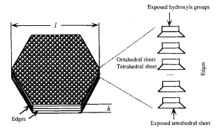
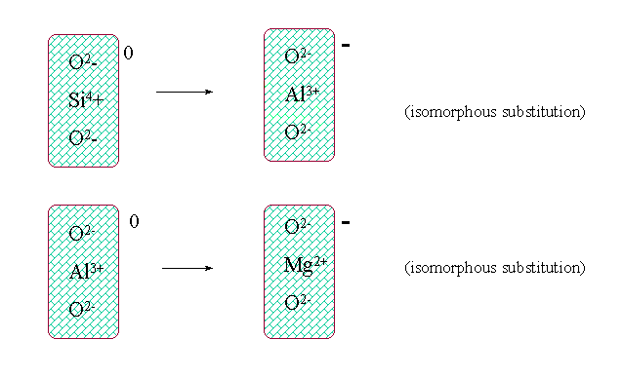
Cation Exchange Capacity
Organic Matter
Charge contributed by OM is termed as “variable charge”
Changes with pH
Protonation and de-protonation of reactive groups
Clay Minerals
Isomorphic substitution and variable charge at broken edges or hydroxyl surfaces

Slide 6
Cation Exchange Capacity
Video
https://www.youtube.com/watch?v=tA_GUUJr-s0

Slide 7
Cation Exchange Capacity
The kind and amount of clays present in the soil affects CEC

Slide 8
CEC and Fertilization Practices
Liming practices vary for soil with widely differing CEC
Ex. Soils with high CEC and high buffering capacity change pH more slowly than low-CEC soils.
CEC can also influence when and how fertilizers can be applied
Ex. On low-CEC soils, some leaching of cations can occur.

Slide 9
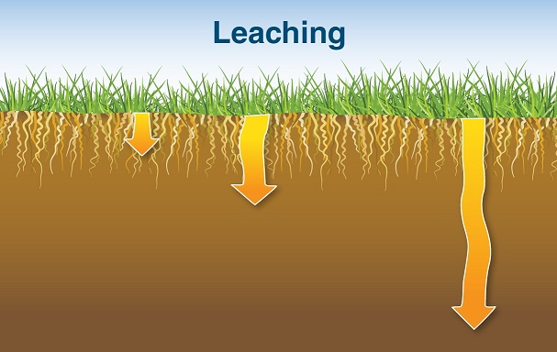
Mobility of nutrients within the soil
Sufficient moisture leaching
Leaching – downward movement of fertilizers through the soil with percolating water

Slide 10
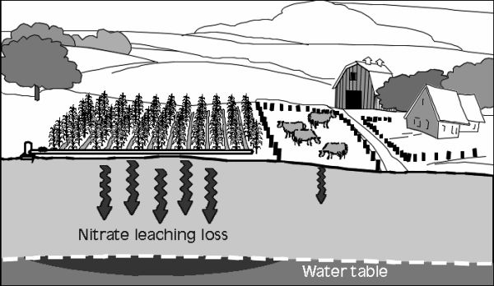
Impacts of leaching nutrients
Environment – groundwater contamination
Agriculture -fertilization
Implementation of 4R approach:
Right Rate
Right Time
Right Source
Right Place

Slide 11
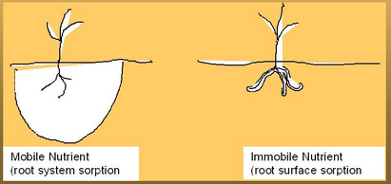
Bray’s Nutrient Mobility Concept
Management of nutrient inputs to correct deficiencies is closely linked to whether the nutrient is mobile in the soil or not
As the mobility of a nutrient in soil decreases the amount needed in the soil increases from a value equal to the product of maximum yield and optimum plant composition to a constant

Slide 12
Nutrient Mobility
Mobile (not T-Mobile):
NO₃⁻
SO₄⁻
Cl⁻
Negative charges repel other negative charges
Somewhat Mobile:
HPO₄²⁻
H₂PO₄⁻
Nutrients are somewhat immobile due to their reactions with other minerals in the soil
Gets bound with Ca, Fe, Al, Mg, etc.
Immobile (also, not T-Mobile): P, K
NH₄⁺
K⁺
Ca²⁺
Mg²⁺
Getting caught on clay particles negative (-) charge

Slide 13
Objectives
Understand the relationship between units commonly used to express cation exchange capacity (CEC) and be able to show that meq/100 g equals cmoles_{(c)}
Learn the CEC of common clays and organic matter
Explain how ions exchange in clays and organic matter and how we can use it to measure cation exchange capacity

Slide 14
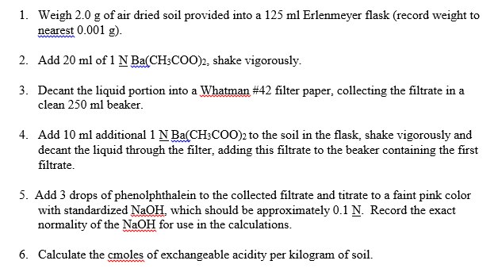
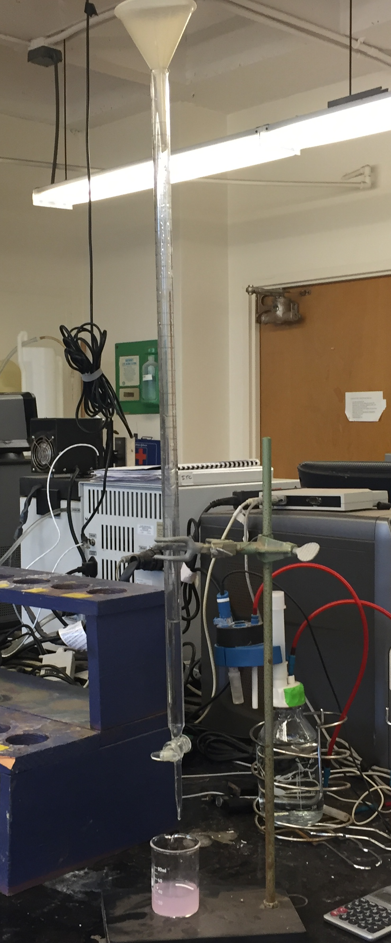
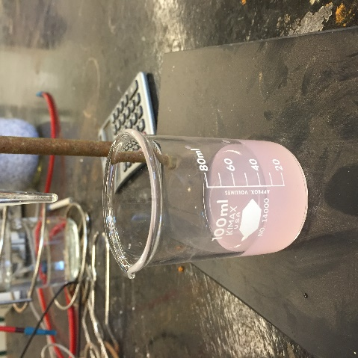
Exchangeable Acidity

Slide 15
Exchangeable Acidity
Ba(CH₃COO)₂ - Barium (Ba²⁺) has s strong enough attraction for the soil exchange sites to pull off the H⁺
Phenolphthalein – used as indicator in acid-base titration; It turns colorless in acidic solutions and pink in basic solutions
NaOH – source of base ions

Slide 16
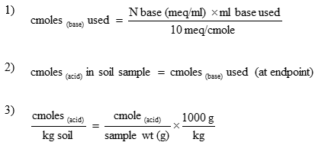
Calculate Exchangeable Acidity

Slide 17
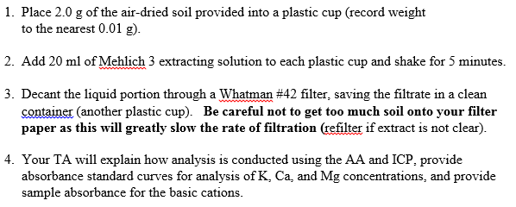
Exchangeable Basic Cation

Slide 18
Exchangeable Basic Cation
Mehlich 3 –talk about more when we get to P and K extraction
Acetic acid: buffers the extracting solution to pH 2.5 when all reagents are added and mixed, thus preventing calcium from being precipitated as calcium fluoride
Ammonium nitrate: facilitates extraction of basic cations such as Ca, Mg, Na and K
Nitric acid: extracts a portion of calcium phosphates; its acid component [H+] aids in extraction of basic and micronutrient cations
Ammonium fluoride: the NH₄+ ion complements ammonium nitrate in extracting basic cations
Ethylenediaminetetraacetic acid (EDTA): chelates micronutrients (Fe, Mn, Zn, Cu); prevents precipitation of calcium fluoride.

Slide 19
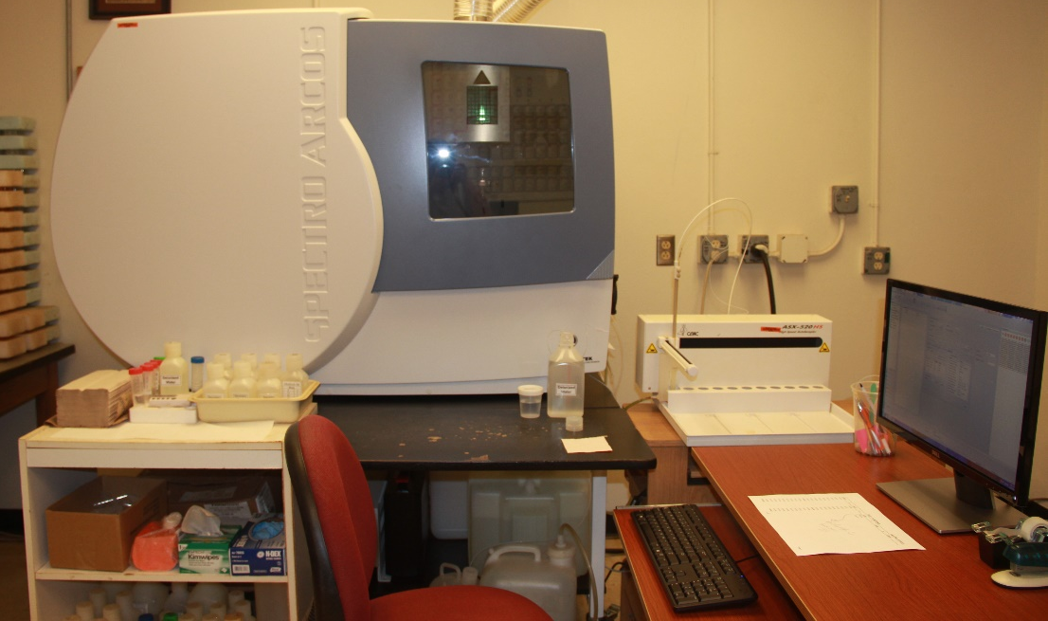
Exchangeable Basic Cation
Inductively Coupled Argon Plasma (ICAP)
Atomic Absorption (AA)

Slide 20
Calculating Exchangeable Basic Cations
Calculate concentration of K, Ca, and Mg from the standard curves

