Slide 1
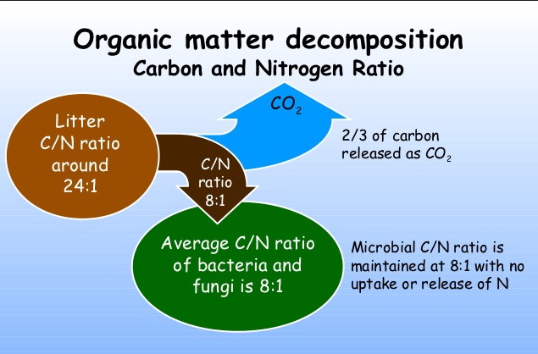
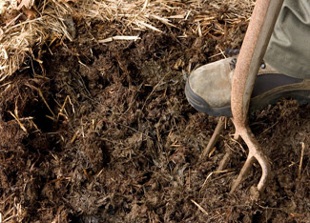
Carbon, Nitrogen, and Organic Matter
SOIL 4234 Laboratory No. 7

Slide 2
Organic Matter: Importance
Complex and chelate metals
Serves as source of nutrients to plants and microorganisms
Contributes to CEC
Aggregate soils

Slide 3
Techniques for measuring OM/OC
Dry Combustion
Loss on ignition using a kiln or muffle furnace
High temperature dry combustion using an automated analyzer
Wet Combustion
Visible Near Infrared Spectroscopy

Slide 4
Dry Combustion: Loss on Ignition
Organic carbon oxidizes to CO₂ and H₂O
Mass loss
Problems with gypsum clays
Carbonates – pre treatment to remove carbonates

Slide 5
Dry Combustion: High Temp - LECO
(g CO₂ (sample) – g CO₂ (blank)
Total C (%) =
x 0.2727 x 100
g of dry soil
Organic matter (%) = 0.35 + [1.80 x percent organic carbon]

Slide 6
Wet Combustion: Walkey-Black Method
Potassium dichromate (K₂Cr₂O₇) is mixed with the soil and concentrated H₂SO₄ is then added.
K₂Cr₂O₇ + H₂SO₄
→ H₂Cr₂O₇ + K₂SO₄ + excess H₂SO₄
Oxidizes organic carbon
CO₂ + chromous sulfate (Cr₂(SO₄)₃

Slide 7
Visible Near Infrared Spectrometry
Uses visible and near-infrared reflectance values
750 nm to about 950 nm
400 nm to about 750 nm

Slide 8
Soils in Oklahoma
Most N is present in organic nitrogen in the soil organic matter
For every 1% OM = 1000 lbs/acre of N
Approximately 98% of the soil N is unavailable for plant uptake
OM is resistant to further decay

Slide 9
C:N Ratio
Microorganisms require mineral N – N release from OM
Microorganisms get their carbon from decaying organic matter
Nitrogen availability
Relative amount of C and N in the OM
Resistance to decay
Environmental conditions – microbial activity

Slide 10
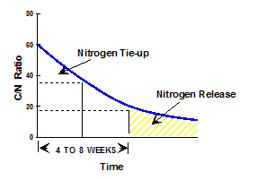
C:N Ratio
C:N Ratio
OM become resistant to decay
MO die off
More mineral, less MO
N not released

Slide 11
C:N Ratio
C:N Ratio
20:1 or less – mineralization
20:1 or more - immobilization

Slide 12
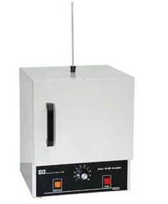
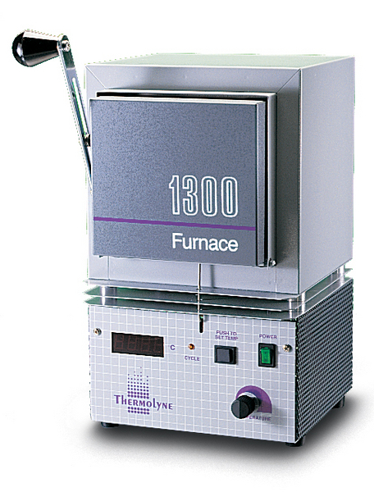
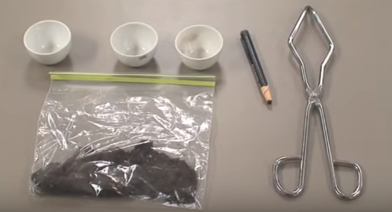
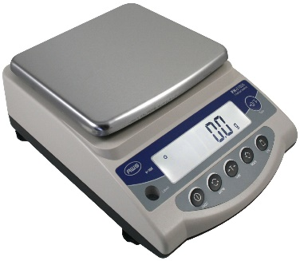
Dry Combustion: Loss on Ignition
Materials needed
Soil sample
Crucibles
Tongs
Weighing scale
Oven
Muffle Furnace

Slide 13
Dry Combustion: Loss on Ignition
Determine soil sample weight (wet weight)
Oven dry = 125ºC overnight
Weigh soil samples (dry weight)
Place dry sample in a muffle furnace
Burn soil samples at 400ºC for 8 to 16 hours
Weigh burned samples (burned weight)
When soil is heated to high temperatures the organic portion oxidizes to CO₂ and H₂O but the majority of soil minerals are left intact.

Slide 14
Dry Combustion: Loss on Ignition
Advantages | Disadvantage
Inexpensive Easy to perform with minimal equipment Uses no chemical | Weight loss can be due to something other than SOM* Rarely applied to low fertility soils for SOM
* Gypsum, montmorillonite, vermicite, and gibbsite - moisture losses of 20-30% of total weight at temperature used for OM oxidation
* Calcareous soil – loss of free carbonates = no distinction between carbonate loss and OC oxidized

Slide 15
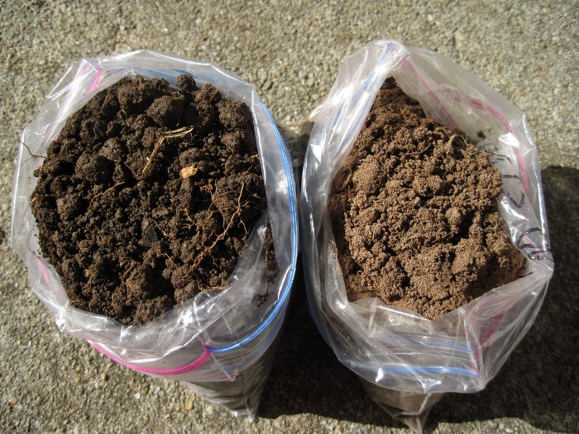
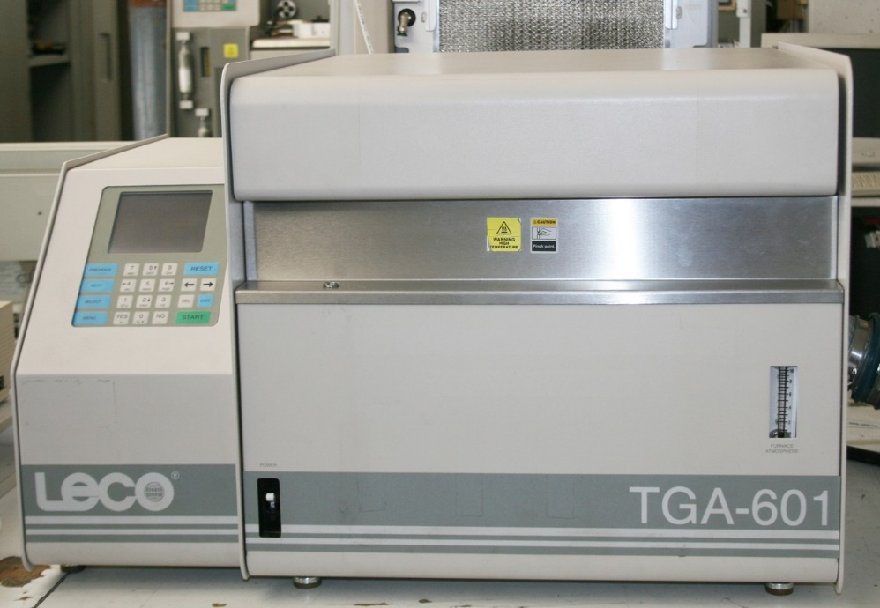
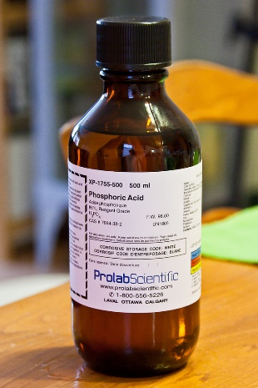
Dry Combustion: Automated Analyzer
Materials needed
Soil sample
LECO automated analyzer

Slide 16
Nitrogen
Amount of Total Nitrogen present in the soil is also measured.
How is this different from Nitrogen previously measured?
Includes organic and inorganic forms of nitrogen
Inorganic N
Ammonia (NH₃)
Ammonium (NH₄⁺)
Nitrite (NO₂⁻)
Nitrate (NO₃⁻)
Organic N
Nitrogen in the form of proteins, nucleic acids found in microbes and organic matter compounds

