Slide 1
Soil Test for Nitrogen
Soil 4234 Lab

Slide 2
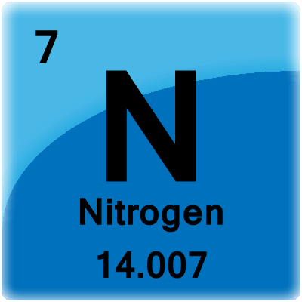
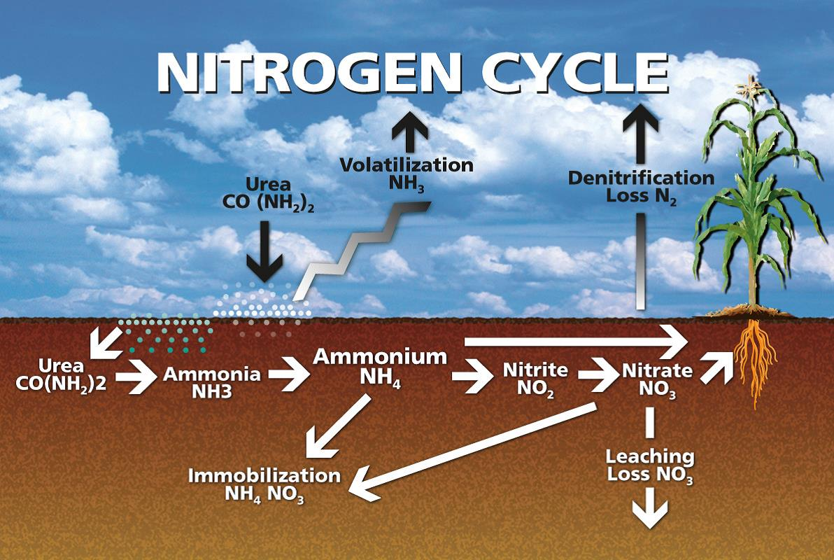
Why Nitrogen?
Required in highest amounts for many crops
Contributes to majority of fertilizer cost for producers

Slide 3
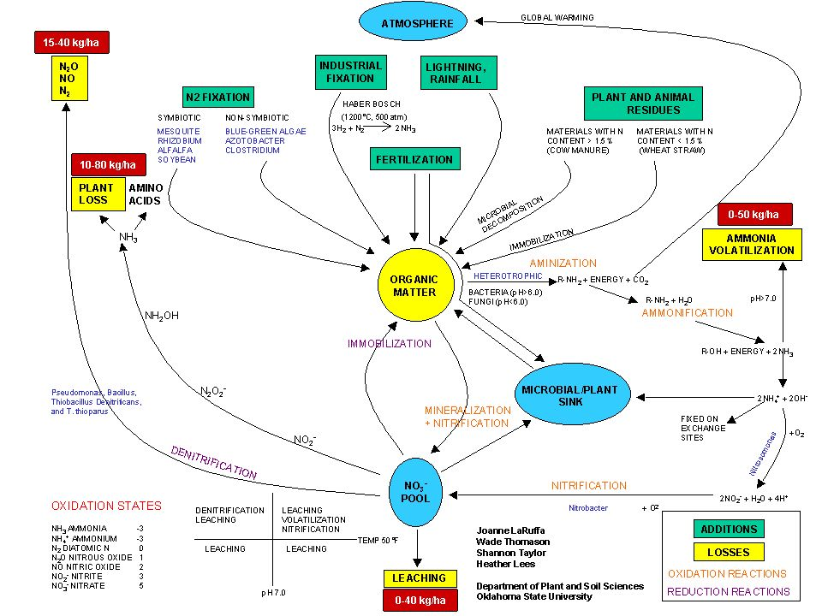

Slide 4
Nitrogen
Fluctuate due to moisture and mobility in the soil profile
This is why sampling closest to N application is required

Slide 5
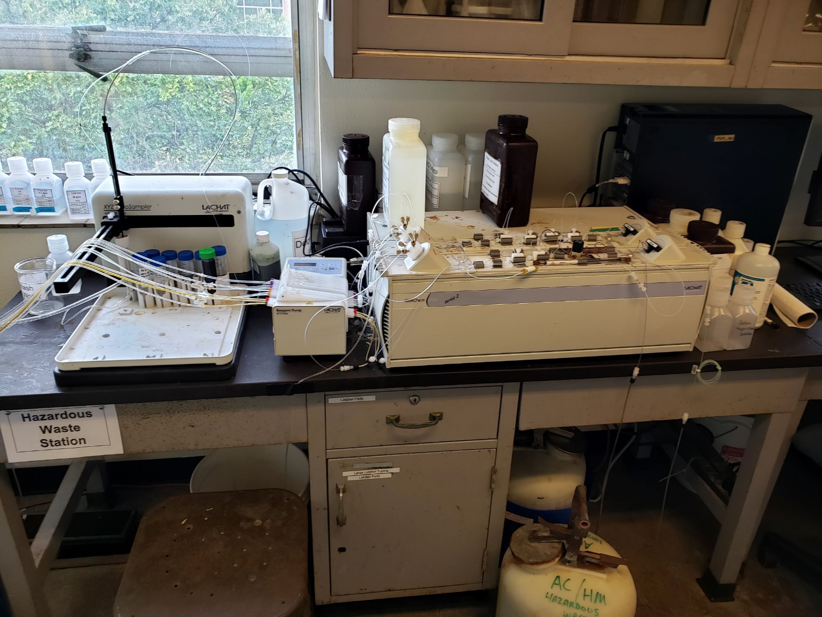
Soil test analysis for Nitrogen
Flow Injection Analysis System
  LACHAT QuickChem 8500
Extractor is KCl
  K⁺
    Strong enough base to remove NH₄⁺ from any bonding sites
  Cl⁻
    Strong enough acid to remove NO₃⁻

Slide 6
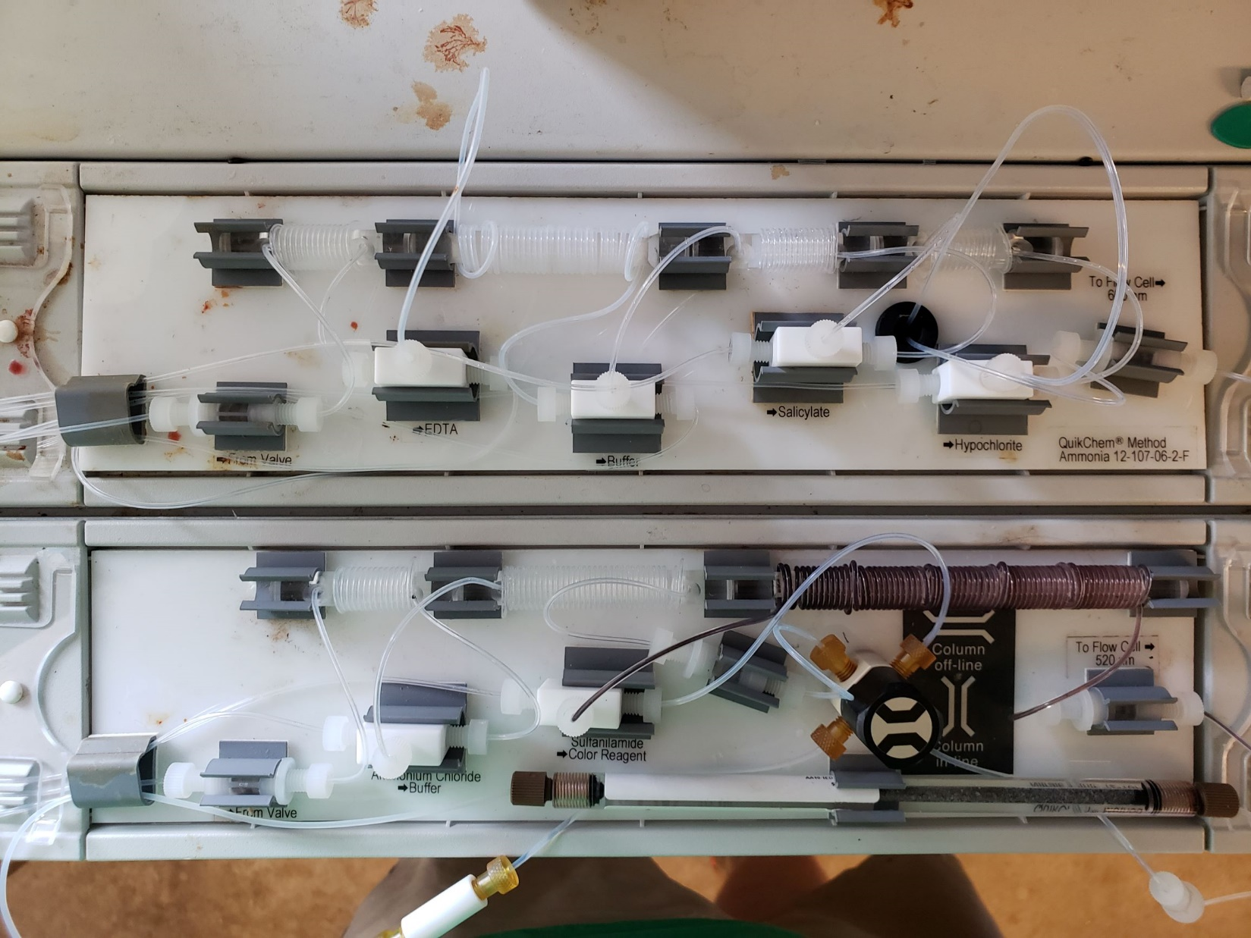
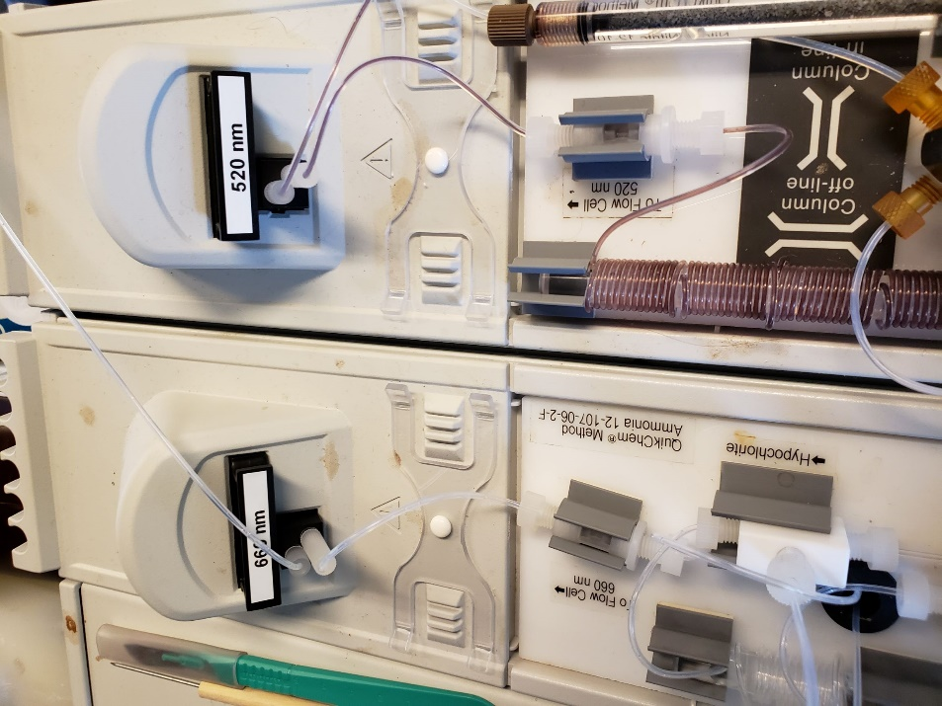
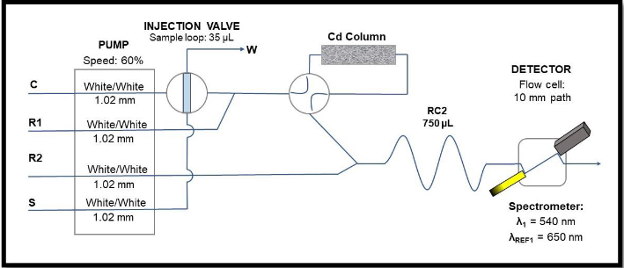
Soil test analysis for Nitrate NO₃⁻
Sample Injected
Reduced from NO₃⁻ to NO₂⁻ in Cd column
Color is read through sensor, through a 520 nm filter, information is then processed by computer
Coloring reagent mixed and given certain time to develop

Slide 7
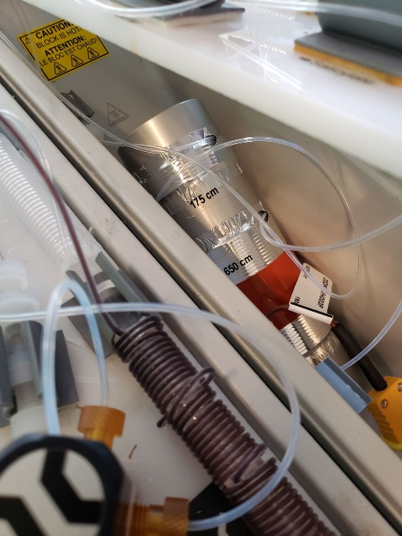
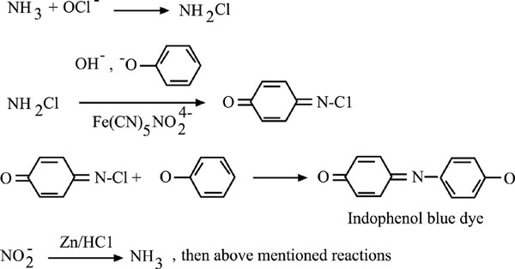
Soil Test Analysis for Ammonium NH₄⁺
Sample Injected
Multiple Reactions

Slide 8
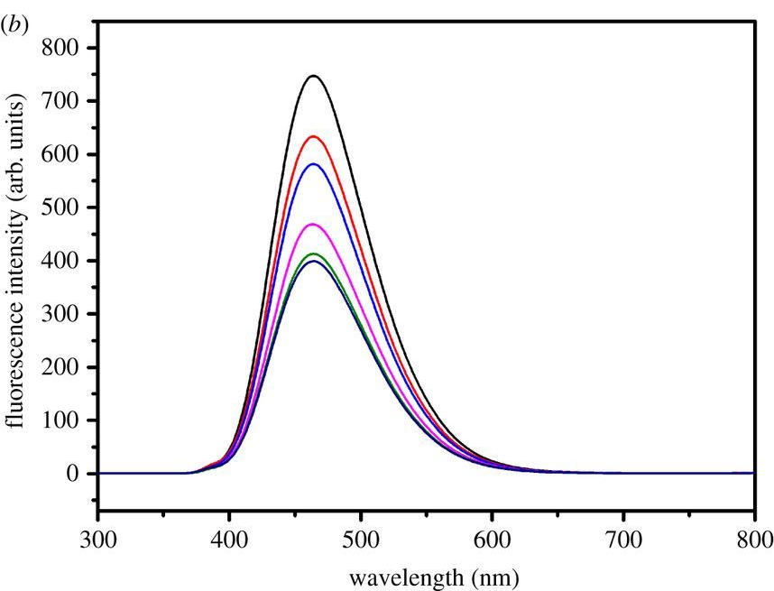
The height of the absorbence curve denotes the concentration of the solution pushed through the Sensor
These values can then be used to calculate the amounts of nutrients found in the extractants.

Slide 9
N Losses in soil
If we look at our N cycle again…

Slide 11
N Losses in soil
If we look at our N cycle again…
4 Avenues of losses:
  Leaching
  Plant Loss
  Volatilization
  Denitrification

Slide 12
N Losses in soil
If we look at our N cycle again…
4 Avenues of losses:
  Leaching: talked about in mobility lab, how its prone to leaching
  Plant Loss
  Volatilization
  Denitrification

Slide 13
N Losses in soil
If we look at our N cycle again…
4 Avenues of losses:
  Leaching
  Plant Loss: can’t control
  Volatilization
  Denitrification

Slide 14
N Losses in soil
If we look at our N cycle again…
4 Avenues of losses:
  Leaching
  Plant Loss
  Volatilization
  Denitrification: Occurs in waterlogged soils, so by keeping well drained soils

Slide 15
N Losses in soil
If we look at our N cycle again…
4 Avenues of losses:
  Leaching
  Plant Loss
  Volatilization
  Denitrification

Slide 16
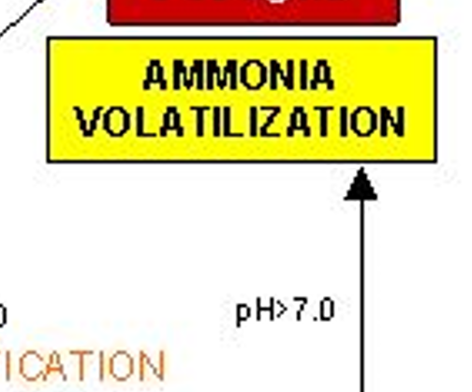

N Volatilization
Volatization is the process of NO₃-N undergoing chemical reaction to become NH₃ gas
$NH_{2}−CO−NH_{2} \left(urea\right)+3H_{2}O \underset{→}{urease} 2 NH_{4}^{+}+OH^{−}+HCO_{3}^{−}$
$NH_{4}^{+}+OH^{−}\underset{↔}{ } H_{2}O+NH_{3} (gas)$
We can see that this reaction provides its own basicity for reaction to occur, even in centralized locations

Slide 17
Objective
To determine NO₃⁻ and NH₄⁺ concentrations from soil samples
To understand how soil chemical and physical characteristics affect N volatilization

