Slide 1
Identification of Nutrient Deficiencies
Brian Arnall Nutrient Management Extension

Slide 2
Nutrient Deficiency ID
Where
Color
Pattern
Soil
Environment

Slide 3
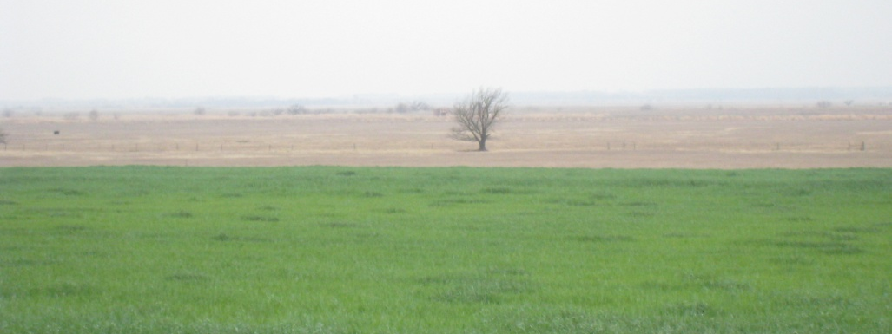
Old Growth
Means the Nutrient is mobile in the Plant
Nitrogen
Phosphorus
Potassium
Magnesium

Slide 4
Nitrogen Deficiency
Nitrogen is mobile in the Plant : Lower/Older Leaves Yellow from the tip toward the mid rib

Slide 6
Phosphorus Deficiency
Phosphorus is mobile in the plant: Lower/Older Leaves
Purpling of the leaf margins or base of stems. Symptoms similar too…
Acidic soils

Slide 8
Potassium Deficiency
Potassium is mobile in the plant: Lower/Older Leaves
Yellow starting at the tip advancing along the leaf margins Brown Scorching along outer margins

Slide 11
Magnesium Deficiency
Magnesium is mobile in the plant: Lower/Older Leaves
Yellowing between the veins Reddish Purple from leaf edge moving inward, cotton soybean canola

Slide 15
New Growth
Means the Nutrient is immobile in the Plant
Iron
Zinc
Manganese
Calcium
Boron
Sulfur
Copper
Chlorine
Molybdenum

Slide 16
Iron Deficiency
Iron is immobile in the plant: Upper/Newer leaves Intervienal chlorosis, stripes narrower than zinc and extend full length of leaf
Calcareous Soils pH >8

Slide 20
Zinc Deficiency
Zinc relatively immobile in plant: Upper/Newer leaves
Purple margins, inward purple blotching,
bleached bands on either side of midrib near base, intervienal chlorosis
Acidic, Sandy soils, Calcareous pH>8

Slide 23
Manganese Deficiency
Manganese is relatively immobile in plant, but can move in xylem sap.
Interveinal chlorosis, very similar to Fe, Mg, N.
Severe deficiencies have brown specs and bronzing
Limited at high pH, Calcareous soils.

Slide 26
Boron Deficiency
Boron is immobile in the plant: Upper/Newer leaves
Wide range of symptoms; necrosis of young leaves and terminal buds,
reddening in some legumes and canola
Well drained sandy soils

Slide 29
Sulfur Deficiency
Sulfur is Immobile in the plant: Upper/Newer leaves.
Similar to nitrogen, yellowing more uniform over leaf. Intervienal Chlorosis.

Slide 33
Sulfur is becoming more of a limiting nutrient in crop production than in the past, for several reasons: higher crop yields require more S; increased use of high analysis fertilizers containing little of no S; reduced amounts of atmospheric S fallout from the sky; and reduced soil S reserves from organic matter losses due to mineralization and erosion. Most S in the soil is tied up in organic matter and cannot be used by the plant until it is converted to the sulfate (SO₄) form by soil bacteria. That process is known as mineralization. Sulfur can be applied as broadcast or banded fertilizer material or applied through irrigation systems (furrow and sprinkler). Sulfur is also an important nutrient for proper nutrition of forage crops that will be consumed by livestock

Slide 34
Copper Deficiency
Copper is Immobile in the plant: Upper/Newer leaves
Stunted growth, terminal dieback, necrosis of meristem, delayed flowering
New leaves uniformly pale

Slide 36
Chlorine Deficiency
Chlorine is mobile in the plant: Lower/Older leaves
Reduced growth, necrotic and chlorotic spots, bronzing in extreme.
Upper leaves will wilt.
Sandy soils

Slide 40
Molybdenum Deficiency
Molybdenum is readily translocated; whole plant
Related to N metabolism, yellowing, stunting, interveinal mottling
Cupping of upper leaves
Soil with low pH and high Fe and Al.

Slide 43
Nutrient Deficiency
Send in photos.
At the end of the year awards go to the best.

