Slide 1
Chapter 5
SOIL AND FERTILIZER N

Slide 2
N₂ Fixation
N-Cycle
Mineralization
Immobilization
Losses
N in plants
NUE
N Fertilization
N Sources
N Application Methods

Slide 3
Definitions
Organic-N: N that is bound in organic material in the form of amino acids and proteins.
Mineral-N : N that is not bound in organic material, examples are ammonium and nitrate-N
Ammonia: A gaseous form of N (NH3).
Ammonium: A positively charged ion of N (NH4+).
Diatomical-N: N in the atmosphere (N2)
Nitrate-N: A negatively charged ion of N (NO3-).
Mineralization : The release of N in the inorganic form (ammonia) from organic bound N. As organic matter is decayed ammonia quickly reacts with soil water to form ammonium, thus the first measurable product of mineralization is usually ammonium-N.
Immobilization: Assimilation of inorganic N (NH4+and NO3- ) by microorganisms.
Nitrification: Oxidation of ammonium N to nitrate N by autotrophic microorganisms in an aerobic environment.
Denitrification: Reduction of nitrate N to nitrous oxide (N2O) or diatomical N gases by heterotrophic microorganisms in an anaerobic environment.
Autotrophic: A broad class of microorganisms that obtains its energy from the oxidation of inorganic compounds (or sunlight) and carbon from carbon dioxide.
Heterotrophic: A broad class of microorganisms that obtains its energy and carbon from preformed organic nutrients.
Volatilization: Loss of gaseous N from soil, usually after N has been transformed from ionic or non-gaseous chemical forms.

Slide 4
Where does all the N come from?
Nitrogen exists in some form or another throughout our environment. It is no wonder all soils and most bodies of water contain some N.
Atmosphere is 78% N in the form of the diatomic gas N₂.
The amount of N₂ above the earth’s surface has been calculated to be about 36,000 ton/acre.
Soils contain about 2,000 pounds of N/acre (12-inch depth) for each 1 % of organic matter content.
N₂ is chemically stable
Considerable energy must be expended to transform it to chemical forms that plants and animals can use.
Common presence in all living organisms of amino-N in the form of amino acids and proteins.

Slide 5
How is N2 transformed?
Natural N fixation.
First transformations of N2 to plant available-N would have been a result of oxidation to oxides of N, which are or become NO₃⁻, by lightning during thunderstorms.
“Fixation” used to identify the transformation of N₂ to plant available-N, and lightening is believed to account for the addition to soils of about 5-10 kg/ha/year.
Since plants could not function without water, and that water is supplied to plants by rainfall (often associated with lightening), the earliest plant forms assimilated NO₃-N as their source of N.
Amount of N2 fixed by lightning may be estimated at about 150,000,000 tons/year, assuming the average is about 6 kg/ha and only about ½ of the earths 51 billion hectares land surface receives sufficient rainfall to be considered.
Relatively insignificant compared to the seasonal N requirement for dense plant populations.
Free-living and rhizobium microorganisms reduce N₂ to amino-N and incorporate it into living cell components.
Azotobacter, clostridium, and blue-green algae (cyanobacteria) are examples of microorganisms that are capable of transforming N₂ to organically bound N, independent of a host plant.
Rhizobium associated with N assimilation by legumes account for transfer of about 90,000,000 tons of N from N2 to biological-N annually. By comparison, worldwide manufacture of N fertilizers by industrial fixation of N₂ is estimated to be about 90 to 100,000,000 tons N annually.

Slide 6
What happens to “fixed” N
Biologically fixed N accumulates on the soil surface as dead plant material and animal excrement.
During favorable conditions, heterotrophic microorganisms decay these materials as a means of satisfying their carbon needs.
N is conserved and C is lost through respiration as CO₂, resulting in a narrowing of the ratio of C to N.
During this process organic material becomes increasingly more difficult for the microorganisms to decay.
Eventually the material becomes so resistant to decay that the decay process almost stops. At this point the ratio of C to N is about 10:1, the material no longer has any of the morphological features of the original tissue (leaves, stems, etc.) and may be categorically termed humus.
N mineralization. During the decay process, and before the organic material becomes humus, there is a release of N from organically bound forms to ammonia (NH₃). Because NH₃ has a strong affinity for water, and the decay process only occurs in moist environments, ammonium (NH₄⁺) is immediately formed according to the following equilibrium reaction:

Slide 7
Organic Matter and OM Processes
Central point of the Nitrogen Cycle
In an acre furrow slice 1000 lbs N per 1% OM
A continuous flow of N into and out of OM.
Immobilization
NO₃ and NH₄ tied up into OM
Mineralization
OM decomposed into NO₃ and NH₄

Slide 8
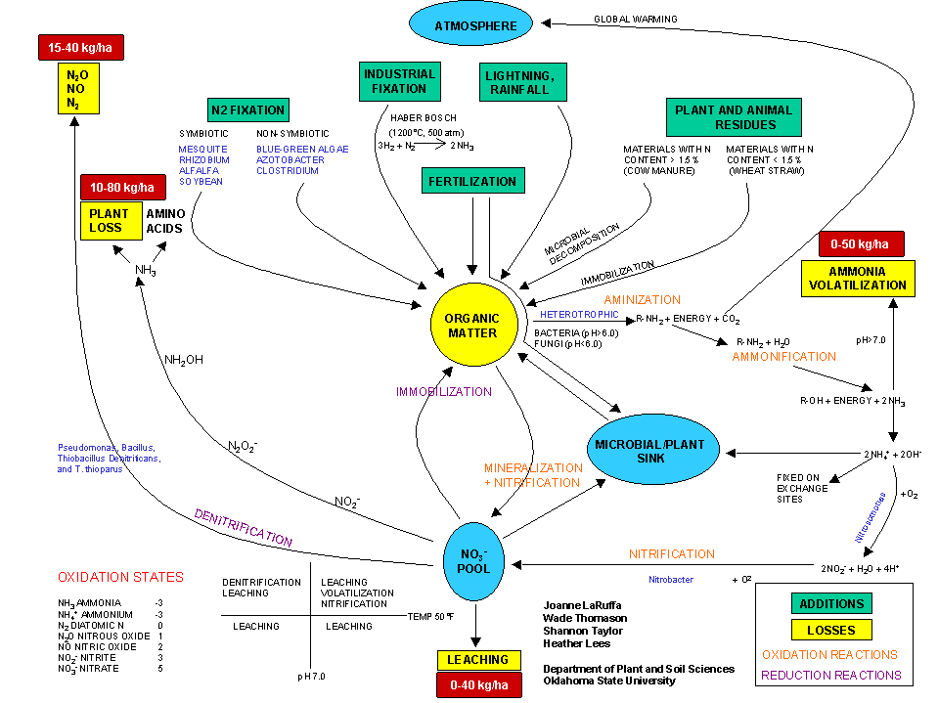

Slide 9
Mineralization
In most environments where decay occurs the entire N transformed from organic-N will be present initially as NH₄⁺. The process of transforming organic-N to inorganic (mineral) N is called N mineralization

Slide 10
Mineralization
Mineralization is favored by conditions that support higher plant growth ( e.g., moist, warm, aerobic environment containing adequate levels of essential mineral nutrients), organic material that is easy to decay, and material that is rich enough in N that it exceeds microorganism N requirements.
Just as plant growth and development takes time, significant mineralization usually requires 2 to 4 weeks under moist, warm conditions.

Slide 11
Immobilization
Decay of plant residue does not always result in mineralization of N.
When residue does not contain enough N to meet the needs of microbes decaying it, the microbes will utilize N in the residue and any additional mineral-N (NH4+ and NO3-) present in the soil.
This process of transforming mineral-N to organic-N is called immobilization, and is the opposite of mineralization.

Slide 12
Immobilization
Immobilization is favored by conditions similar to those for mineralization, except that residue is poor in N (higher ratio of C to N).
When conditions are favorable for immobilization, and non-legume crops (turf, wheat, corn, etc.) are growing in the same soil, microbes will successfully compete for the available N resulting in crop N deficiencies.

Slide 13
Mineralization-immobilization
Occurs within a growing season and influences plant growth and the need for in-season N management.
When organic matter has a C:N ratio > than 30, NO₃ initially present in the soil is consumed (immobilized) by microbes during the decay process.
As a product of the decay process (respiration) CO₂ content in the soil gradually increases.
Because C is lost and N is conserved, the C:N ratio becomes narrower until it is finally < 20, at which point nitrate begins to accumulate (mineralization).

Slide 14
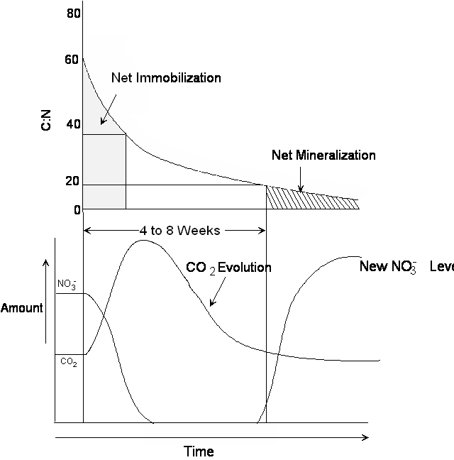

Slide 15
NH4 and NO3
Nitrification transforms plant available-N from a soil-immobile form (NH₄⁺) to a soil-mobile form (NO₃⁻).
Important in arid and semi-arid environments, where considerable water movement in soil is necessary to supply the needs of plants (large root system sorption zone).
Only small concentrations (10-20 ppm) of NO₃-N are necessary in a large volume of soil to meet the N needs of plants that may have to grow rapidly during a short rainy season.
In arid and semi-arid soils, that usually are calcareous and have pH of 7.5 or greater, N accumulated over time as a result of mineralization would be at high risk of loss by volatilization as NH₃.
As somewhat of a safeguard against NH₃ being volatilized, acidity produced by nitrification neutralizes OH- resulting from mineralization and tends to acidify the environment as long as NO3- is accumulating in the soil.

Slide 16
Nitrification
Ammonium-N may be biologically transformed to NO₃⁻ in a two-step process called nitrification. Nitrification proceeds at about the same rate and under similar conditions as mineralization and immobilization, but has an absolute requirement for O₂

Slide 17
Nitrite
Nitrite (NO₂⁻) does not accumulate in well-aerated soils because the second step occurs at a faster rate than the first, and so it is quickly transformed to NO₃⁻. Because NO₂⁻ is not normally found in soils it is toxic to plants at concentration of about only 1-2 ppm.

Slide 18
SUM

Slide 19
Production of H+
The nitrification process is often viewed as a cause of soil acidification because of the H⁺ shown as a product.
2 moles of H+ are produced for every mole of NH₄⁺ that is nitrified.

Slide 20
Lime required to neutralize the soil acidity produced by fertilizers if all ammonium-N is converted to nitrate-N.
Nitrogen source | Chemical Formula | Composition | Lime required (lb CaCO₃ / lb N)
Anhydrous ammonia | NH₃ | 82-0-0 | 1.8
Urea | (NH₂) ₂ CO | 46-0-0 | 1.8
Ammonium nitrate | NH₄ NO₃ | 34-0-0 | 1.8
Ammonium sulfate | (NH₄) ₂SO₄ | 21-0-0-24 | 5.4
Monoammonium phosphate | NH₄H₂PO₄ | 10-52-0 | 5.4
Diammonium phosphate | (NH₄) ₂HPO₄ | 18-46-0 | 3.6
Triple super phosphate | P₂O₅ | 0-46-0 | 0.0
Adapted from Havlin et al., 1999.

Slide 21
However, if the OH⁻ generated by N mineralization is considered then for the process of mineralization and nitrification…
And the sum affect of these two processes, with NH₃ and NH₄⁺ as intermediates not shown in the final reaction occuring in a moist, aerobic environment would be…..

Slide 22
N and Acidity
When organic forms of N are the source of NO₃⁻ used by plants, only one mole of H⁺, or acidity, is produced from each mole of N taken up by the plants.
As NO₃⁻ is metabolized and reduced to amino-N, the H⁺ is either neutralized or assimilated in the process and use of organic-N or amino-N by plants is not an acidifying process.

Slide 23
Nitrification

Slide 24
Urea

Slide 25
Nitrogen Losses
Leaching
NO₃ – follows water flow.
Ammonia Volatilization
NH₄ at a pH >7 H is stripped off and NH₃ (gas) formed.
Denitrification
NO₃ in waterlogged soil. Microbes strip O off
Plant Loss
NO₃ and NH₄ converted to NH₃ in plant, in stress NH₃ gassed off.

Slide 26
Ammonium
Cation exchange.
As the concentration of NH₄⁺ in the soil increases, NH₄⁺ will successfully compete for exchange sites on clay and humus occupied by other cations. This adsorption is responsible for NH₄⁺-N being immobile in the soil.
Volatilization.
If the environment is basic enough (high concentration of OH-) the equilibrium will favor the reaction to the left.
When this occurs there is the potential for loss of N by volatilization of NH₃ gas.
Volatilization is most likely to happen in high pH soils,
Also occurs in acid soils when NH₄⁺ accumulates from decay of N rich crop residue or animal manures on the soil surface.
This condition is present in range and pasture situations as well as crop land where residue is not incorportated (no-till or minimum till). Volatilization is also promoted by surface drying, as removing H₂O from reaction (1) shifts the equilibrium in favor of the reaction to the left.

Slide 27
Nitrate
Leaching. Nitrate-N is subject to loss from the root environment with water percolating through the soil. This is a significant problem when soils are porous (sandy) in high rainfall or irrigated condition.
It is not believed to be a problem in arid and semi-arid, non-irrigated soils.
Denitrification. When soils become anaerobic (e.g., there is little or no O₂ present) and conditions favor microbial activity, some microorganisms will satisfy their need for oxygen by stripping it from NO₃⁻. As a result, gaseous forms of N (nitrous oxide, N₂O, and N₂) are produced that may be lost from the soil to the atmosphere above. The generalized process may be represented as:

Slide 28
Denitrification
Microorganisms responsible for denitrification are generally believed to be heterotrophic facultative anaerobes.
They use organic matter as a carbon source and can function in either aerobic or anaerobic environments.
Denitrification is promoted in soils that contain NO₃⁻, organic matter that is easy to decay, and where O₂ has been depleted by respiration (root or microbial) or displaced by water (waterlogged).
In addition to the problem of N loss, the intermediate NO₂⁻ may accumulate to toxic levels when the process is incomplete

Slide 29
How are these N transformations interrelated?
The product of one reaction is a reactant for another
This interrelationship is illustrated in the N-cycle
It is important to consider how change in the concentration of one component of the cycle (e.g., NH4+) can have a ‘ripple’ effect (like a pebble thrown into a pond) throughout the cycle
temporarily affecting plant uptake of N
immobilization by microbes
exchangeable bases
Nitrification
or it may only affect one process, as in the case when NH4+ is produced as a result of mineralization occurring at the surface of a moist, alkaline (high pH) soil where it is quickly lost by volatilization when the surface dries in an afternoon.
As easy as it may be to illustrate the interrelationship of these processes in the cycle, it is another matter (difficult) to understand how they influence our management of N to grow plants.

Slide 30
N In a Natural System
Important aspect of the N-cycle is that it is nature’s way of conserving N.
In nature there is likely seldom more than a few (1-5) ppm of N present in the form of either NH₄⁺ or NO₃⁻.
Thus, although there are processes (leaching and volatilization) that can remove excess N from the natural system, these are not likely to be active except in extreme situations.

Slide 31
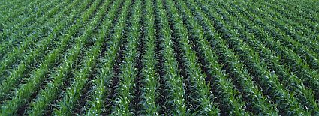
Plant Uptake
Plant uptake. When higher plants are actively growing they will absorb NH₄⁺. When plant absorption proceeds at about the same rate as mineralization there will be little or no accumulation of NH₄⁺ in the soil.
However, since NH₄⁺ is not mobile in the soil, in order for all the NH₄⁺ to be absorbed it would be necessary for plant roots to be densely distributed throughout the surface soil.
Condition represented by dense plant cover in tropical ecosystems and in turfgrass environments.

Slide 32
How does the N-cycle influence commercial plant production
When plants are harvested and removed from an area, N is also removed from the soil of that area.
Large removals occur with annual cereal grain production
Cultivation stimulates N mineralization and nitrification, resulting in gradual depletion of soil organic-N and soil organic matter.
Many prairie soils of the central Great Plains and corn belt regions of the US have lost one-third to three-fourths of their original organic matter content as a consequence.
The use of legume crops in rotation with non-legumes and the N fertilizer industry grew out of a need to replace the depleted soil N.

Slide 33
Mineralization of N in legume residue
Because legumes seldom lack N in their growth and development, their residue is rich in N (high protein),
C:N ratio is < 20:1 and N mineralization will be favored.
When non-legumes, like corn, are rotated with a legume, such as soybeans (common in the corn belt of the US), soybean residue may contribute 30 to 50 lb N/acre to the corn needs
Soybean-corn system, without N, yields about the same as the 40 lb N rate for the corn-corn system.

Slide 34
Rotations
Corn planted following alfalfa…
Perennial legume has usually been growing for 4 to 10 years,
Accumulated residue, and existing growth when the alfalfa was destroyed by cultivation, provides a large amount of N-rich organic residue.
Sufficient to meet N needs of the first year of corn production following alfalfa.
As the residual contribution from alfalfa becomes less and less each year, there is an increasing corn response to the application of fertilizer-N.
Response of non-legumes to mineralization of N from legume residue is commonly observed
Result is entirely due to the high protein or N-rich residue of the legume.
Inter-seeding legumes into non-legume forages will also increase crude protein content of the mixture.
Not a result of the legume somehow providing available plant N directly to adjacent non-legume plants.

Slide 35
Mineralization of N from non-legume residue
Legume residue: narrow C:N ratio because it was grown in a N-rich environment
N not limiting
N-rich residue is created whenever non-legumes are grown in a N-rich environment as a result of fertilizer input at levels that exceed crop requirement.
Response is not linear, as might be predicted for a mobile soil nutrient according to Bray’s mobility concept.
Why?
Some of the fertilizer-N is immobilized when the soil is enriched with mineral N
Some of the mineral N is lost from the system because of the mineral N enrichment.
N-cycle is effective in conserving N in a natural ecosystem, when large quantities of N are introduced
When excesses exist, system is not as efficient
System should be viewed as one that buffers against mineral N changes and one that leaks when mineral N is present in excess.
Most efficient N fertilization program would be one that most closely resembles the natural supply of N from the soil to the growing plants.
This system would add minute amounts of mineral N to the soil at a location where the plant could absorb it each day. Such a system is usually not economically feasible because of the high cost of daily application.

Slide 36
Nitrogen Use Efficiency
NUE of cereal grain production World Wide averages 33%
Meaning only .33lb of every lb applied is utilized by crop.
Meaning for every $1 of N purchased there is no return on $.77
NUE Calculated as.
(N removed from fertilized-N removed from check)/N applied.
(40 bu – 20 bu) / 80 lbs N.
N wheat grain 1.5 lb N/ bu
(40*1.5-20*1.5) / 80 lbs N
(60-30) / 80
30/80
37.5%

Slide 37
N Response

Slide 38
Mineralization of Soil-N
Corn yield of about 70 bushels/acre when no fertilizer-N is applied to a field that grows corn year after year, without a legume in rotation.
N to support this yield is believed to come primarily from soil-N in the organic fraction, that is, N mineralized since the last crop was grown and during the growing season.
For this example the mineralized, or non-fertilizer N, supports about one-third of the maximum yield.
Less difference between fertilized and unfertilized yields for dryland than for irrigated systems in arid and semi-arid environments.
Large differences in plant response between fertilized and unfertilized areas are common, for example, in irrigated turf where clippings are removed.

Slide 39
Midfield bermudagrass turf response to fertilizer N (rates are equivalent to 0.5, 1, 1.5, 2, 4, and 6 lb N/1000 square feet. From Howell, OSU M.S. thesis, 1999).

Slide 40
NUE
NUE = 50 % at the lowest input of fertilizer
Decreases to about 35 % at maximum yield.
Low NUE is believed to result from increasingly large “excesses” of mineral N being present because all fertilizer was applied preplant, without knowledge of yield potential or supply of non-fertilizer N.

Slide 41
How profitable is it to fertilize for maximum yield?
Using 31-year average yield response data profitability of each 20-lb/acre addition of N can be examined by considering different prices (value) for wheat and fertilizer-N (cost).
Using $0.25/lb N cost: most profitable rate may easily vary by 20 lb N/acre depending upon value of the wheat.
Since the 31-year average yield response data fit a quadratic response model, the law of diminishing returns applies, and the last 20 lb N increment that increases yield (60 to 80 lb) always has less economic return.
When the value of wheat is $2.00/bushel the maximum economic rate of N is 60 lb/acre, even though the maximum grain yield is from 80 lb N/acre.

Slide 42
How variable are crop N needs from year to year?
Crop yields change year-to-year depending on weather conditions.
Need for nutrients like N also varies.
Should we apply the same amount of N each year?
Considerable year-to-year variability in how much N is supplied by the soil
Tendency for the unfertilized yield to decrease slightly over time (about 0.1 bu/acre/year), and that the amount of non-fertilizer N available to the crop varies greatly from year-to-year.
Decrease in supply of non-fertilizer N with time
Continued crop production without fertilizer mines soil organic-N.

Slide 43
Yield

Slide 44
N-Rate

Slide 45
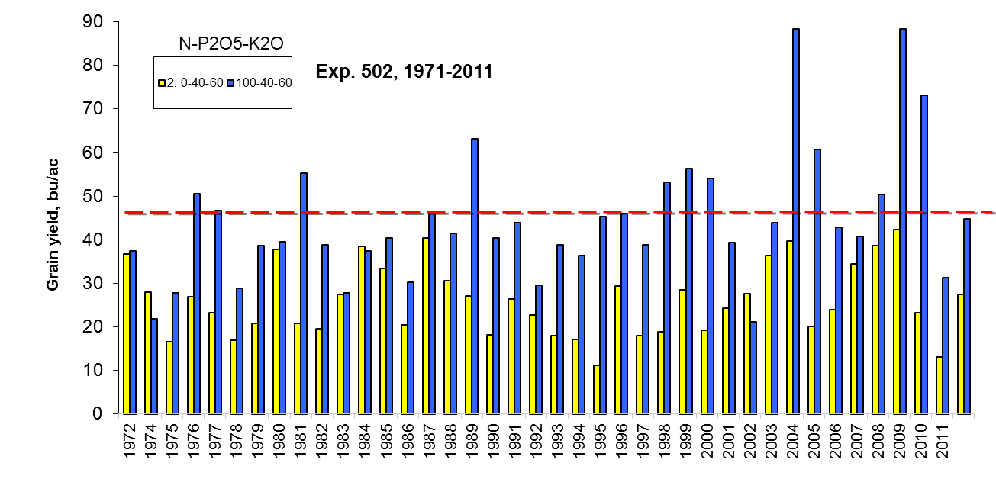
Choosing the yield goal.

Slide 46
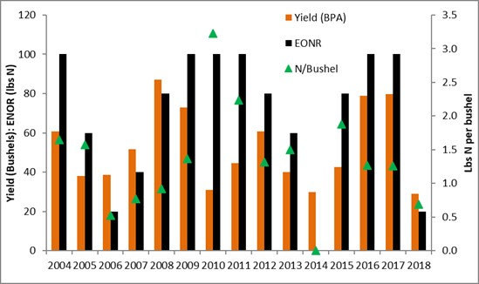
Lahoma Nitrogen

Slide 47
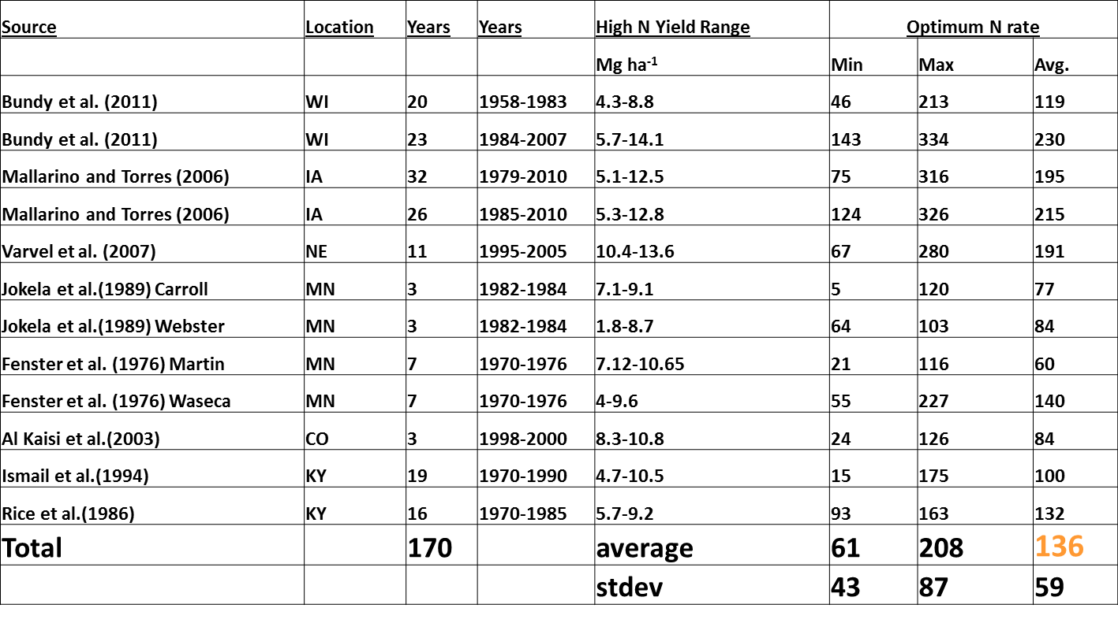
Corn…
1 Mg/ha = 15 bpa, 5 Mg = 75 bpa, 10 Mg=150 bpa, 15 Mg= 225 bpa

Slide 48
Calculating Nitrogen Rate
Oklahoma State Recommendation
2 lbs. N per bushel
Yield Goal bu/ac*2 – Soil test N
Yield Goal 5 Five average + 20% or highest 3 of last 5.

Slide 49
Calculating Nitrogen Rate
Stanford Eq.
JEQ Vol 2 No 2 1973 pgs 159-166
N rate from Three Simple numbers
Nitrogen Uptake by plant
Nitrogen Supplied by Soil
Efficiency of Fertilizer
N Rate = (Nup – SoilN) / Eff.

Slide 50

Nitrogen Uptake by plant
In short:
Identify the final yield………..
Account for N in grain/biomass.

Slide 51
Yield
Yield Goal
Use of Averages or Soil Capabilities

Slide 52
Yield goal/Expected /Proven
Undefined
Realistic target yield that is achievable with favorable growing conditions (MD)
5-year average
5-year avg. + 5-10% (NE)
Expected yield in 3-4 years of 5 under good management (NY)

Slide 53
Proven yield – South Dakota
Proven Yield (5 year data minus outliers)
Proven Yield + 10%
Proven Yield Modified for Soil Moisture (±10-20%)
Modified County Averages
Avg. yield increase about 1.8 bu/a/year annually (<2% per year and diminishing)

Slide 54
Aggressive – Oklahoma
Yield goals should be sufficiently greater than long-term average yields to insure nitrogen will not be the factor limiting crop production during years with better than average growing conditions. As a rule of thumb, the average yield from the last five years plus 20 percent is an appropriate yield goal.

Slide 55
Percent N used.
Crop | Average %N | Test wt, lb/bu
Corn (USA) | 1.25 | 56
Winter Wheat | 2.39 | 60
Winter Wheat Forage | 2.46
Spring Wheat (Dakota's) | 2.4 | 60
Wheat Argentina | 2.2 | 60
Sorghum | 1.95 | 56
Bermudagrass | 2 | na
Cotton Lint | 8.637
Durum Wheat | 2.24 | 60
Canola (Canada) | 3.3 | 50

Slide 56
Nitrogen Supplied by Soil
Residual and Additions
Mineralization
Immobilization
Credits – Legumes, Cover crops, Manures,
Mineralization of these
Loss Pathways

Slide 57
4 Losses
Leaching
NO₃ – follows water flow.
Ammonia Volatilization
NH₄ at a pH >7 H is stripped off and NH₃ (gas) formed.
Denitrification
NO₃ in waterlogged soil. Microbes strip O off
Plant Loss
NO₃ and NH₄ converted to NH₃ in plant, in stress NH₃ gassed off.

Slide 58
Efficiency of Fertilizer
What percentage applied can be used.
Source
Timing
N-Cycle

Slide 59
Fertilizer Sources

Slide 60
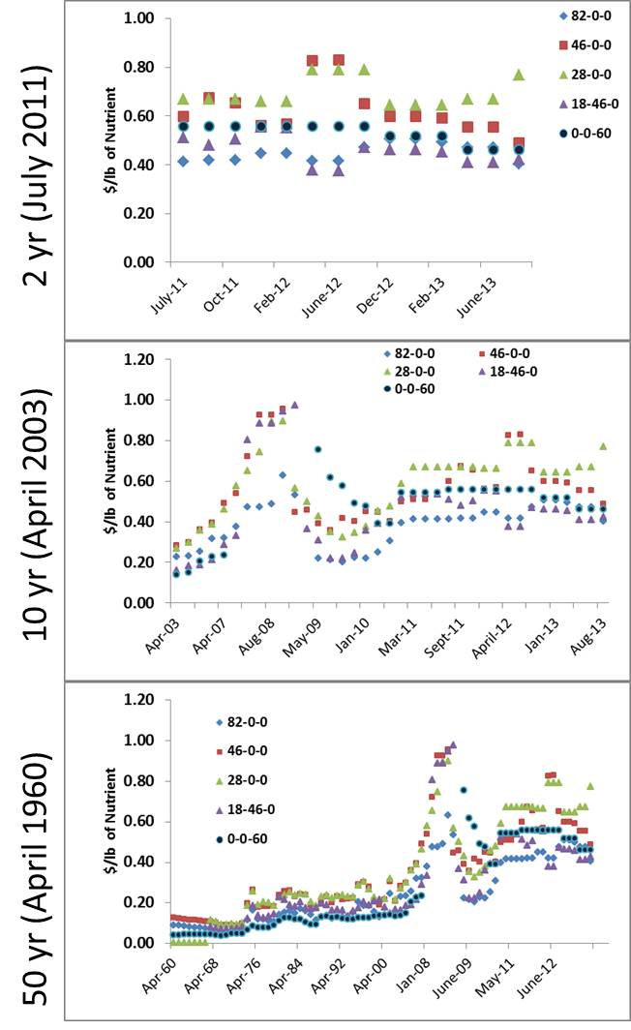

Slide 61
N Fertilizers
All N fertilizer materials are synthesized while P and K fertilizers are processed, natural deposits.
Of the synthesized N fertilizers, urea is an organic fertilizer and the others are not.
(NH₂)₂CO

Slide 62
Lime required to neutralize the soil acidity produced by fertilizers if all ammonium-N is converted to nitrate-N.
Nitrogen source | Chemical Formula | Composition | Lime required (lb CaCO₃ / lb N)
Anhydrous ammonia | NH₃ | 82-0-0 | 1.8
Urea | (NH₂) ₂ CO | 46-0-0 | 1.8
Ammonium nitrate | NH₄ NO₃ | 34-0-0 | 1.8
Ammonium sulfate | (NH₄) ₂SO₄ | 21-0-0-24 | 5.4
Monoammonium phosphate | NH₄H₂PO₄ | 10-52-0 | 5.4
Diammonium phosphate | (NH₄) ₂HPO₄ | 18-46-0 | 3.6
Triple super phosphate | P₂O₅ | 0-46-0 | 0.0
Adapted from Havlin et al., 1999.

Slide 63
Anhydrous ammonia (82-0-0)
The leading N fertilizer in terms of tons sold nationwide is anhydrous ammonia (82-0-0). It is manufactured by combining atmospheric N₂ with H in an environment of high pressure and temperature that includes a catalyst.

Slide 64
NH₃
The common source of H is from natural gas (CH₄). Important properties of anhydrous ammonia are listed below
Very hygroscopic (water loving)

Slide 65
NH3
The strong attraction of anhydrous ammonia for water is identified chemically by the equilibrium reaction
(NH4⁺)(OH⁻) = 10^{-4.75} (NH₃)
(OH⁻)=10⁻¹⁴/H⁺
pH = 14-4.75
pH = 9.25

Slide 66
NH4+ + OH- ---> NH4OH ---->NH3 + H2O
pH = pKa + log [(base)/(acid)]
At a pH of 9.3 (pKa 9.3) 50% NH4 and 50% NH3
pH Base (NH3) Acid (NH4)
7.3 1 99
8.3 10 90
9.3 50 50
10.3 90 10
11.3 99 1

Slide 67
NH₃
pH 7: ratio of NH4⁺/ NH3 is about 200:1,
Strong tendency for the reaction to go to the right.
Undissociated NH₄OH does not exist in aqueous solutions of NH₃ at normal temperature and pressure.
If undissociated NH₄OH did exist, it would provide a form of N, other than NO₃⁻ that would be mobile in the soil.
Anhydrous ammonia is a hazardous material and special safety precautions must be taken in its use. Most important among these is to avoid leaks in hoses and couplings, and to always have a supply (5 gallons or more) of water available for washing.
Anhydrous ammonia injected: reacts immediately with soil-water.

Slide 68
NH₃
Dry soils: sufficient hygroscopic water present to cause reaction [1] to take place. When there is insufficient water present (e.g. dry, sandy soil) to react with all the NH₃ (high rate of N, shallow application depth), some NH₃ may be lost to the atmosphere by volatilization.
Losses are minimized by injecting NH₃ at least 4” deep in loam soils and 6” deep in sandy soils for N rates of 50 lb N/acre.
As rates increase, depth of injection should be increased and/or spacing between the injection points decreased.
In all application situations it is important to obtain a good “seal” as soil flows together behind the shank or injection knife moving through the soil. Packing wheels are sometimes used to improve the seal and minimize losses.
Blue Jet

Slide 69
NH₃
Least expensive source of N.
Cost of natural gas strongly influences the price of anhydrous ammonia
N source for manufacturing other N fertilizers
Widest use in corn and wheat production
Not recommended for use in deep, sandy soils because of the risk of leaching associated with the deeper injection requirement and lower CEC of these soils.
Sometimes used with a nitrification inhibitor, such as N-Serve (also called nitrapyrin) or fall applied when soil temperatures are cold enough to minimize nitrification and leaching loss and risk of groundwater contamination.
Good source of N for no-till systems since immobilization is minimized by band injections. Does not cause hard pans, acid soils, or reduced populations of microorganisms and earthworms, as is sometimes suggested.

Slide 70
NH3
Anhydrous

Slide 71
Urea (46-0-0)
Most popular (based on sales) solid N fertilizer.
Produced as either a crystal or prill (small bead-like shape).
Very soluble in water, highest analysis solid material sold commercially.
Not hazardous and has low corrosive properties
Hygroscopic (attracts water) and requires storage free of humid air.
Mobile in soil because it remains an uncharged molecule after it dissolves.
After it dissolves it hydrolyzes to ammonium, bicarbonate and hydroxide in the presence of the enzyme urease

Slide 72
Urea
Urease is present in all soil and plant material
Hydrolysis of urea will occur on the surface of moist soil, plant residue, or living plant material if the moist environment is maintained for about 24 hours.
If, after hydrolysis has taken place, the environment dries, N may be lost (volatilized)

Slide 73
Urea
Environments that are already basic (high pH soil) and lack exchange sites to hold NH₄⁺ (sandy, low organic matter soils) will favor loss
Easy to blend with other fertilizers, but should be incorporated by cultivation, irrigation or rain within a few hours of application if the surface is moist and temperatures are warm (>60°F)
There apparently is little or no loss of ammonia when urea is surface applied during cool weather or remains dry during warm weather

Slide 74

UREA
H₂O: Rain, Mist, Dew, Humidity, Soil Moisture
(NH₂)₂ CO₂
NH₃ (gas)
H₂O
SOIL
Urease
SOIL
NH₄
NH₄
NH₄
NH₄

Slide 75
Ammonium Nitrate (33-0-0)
Use of ammonium nitrate fertilizers decreased with increasing use of urea in the 1980’s.
Preferred for use on sod crops, like bermudagrass hayfields
Since the bombing of the Federal Building in Oklahoma City April 19, 1995, fertilizer dealers are even more reluctant to include it in their inventory of materials. Because ammonium nitrate has been popular for homeowners, some retailers continue to carry a 34-0-0 material that is a blend of urea and ammonium sulfate or other materials.
Thus, they are able to sell a fertilizer of the same analysis, but which has no explosive properties. Although ammonium nitrate is widely used as an explosive in mining and road building, the fertilizer grade (higher density) is not considered a high risk, hazardous material and accidental explosions of the fertilizer grade are extremely rare.
Ammonium nitrate is hygroscopic, like urea, and will form a crust or cake when allowed to take on moisture from the atmosphere.
Unlike urea, loss of N as NH₃ volatilization is not a problem with ammonium nitrate. This fertilizer is corrosive to metal and it is important to clean handling equipment after use.
A major advantage of ammonium nitrate fertilizer is that it provides one-half of the N in a soil-mobile form. This is often justification for use in short-season, cool weather, vegetable crops and greens like spinach.

Slide 76
N Fertilizers
UAN (urea-ammonium nitrate) solutions
Urea and ammonium nitrate are combined with water in a 1:1:1 ratio by weight =28 %N solution.
Popular for use as a topdressing (application to growing crop) for winter wheat and bermudagrass hayfields.
Because it has properties of both urea and ammonium nitrate, its use is discouraged for topdressing during humid, warm, summer periods when volatilization of NH₃ from the urea portion could occur.
Can serve as a carrier for pesticides
Solution 32 is a similar material that simply is more concentrated (contains less water) Precipitates (salts out) when temperatures are below about 28°F.
Solution 28 does not salt out until temperatures reach about 0°F.
Ammonium sulfate (21-0-0)
Dry granular material that is the most acidifying of the common N fertilizer materials because the N is in the ammonium form.
When urea is hydrolyzed to form NH₄⁺, there are two ‘basic’ anions (OH⁻ and HCO₃⁻)
Neutralizes some of the H⁺, formed when NH₄⁺ is nitrified to NO₃⁻.
Because the analysis of N is relatively low, compared to other dry materials, there is not much market for ammonium sulfate and its cost/lb of N is relatively high. As a result its use is limited to specialty crops, lawns and gardens, and in blended formulations that need S.

Slide 77
Slow-release fertilizers
Slow Release
Prevents immediate release into soil where environment and biological’s have impact.
Coated
Chemistry
Inhibitors
Prevent the biological activity that impacts the Nitrogen Cycle
Since early 60’s at least 15 substances thoroughly researched

Slide 78
Slow-release fertilizers
Two to three (or more) times more expensive than urea or ammonium nitrate
Not used in conventional agriculture, but rather in production systems that are less sensitive to fertilizer costs and which desire a somewhat uniform supply of N to the plants over the cycle
Turfgrass systems:
Advantage of these materials is that one application may provide a uniform supply of N to the plants for several weeks.
Urea-formaldehyde (38 %N) is a synthetic organic material of low solubility, whose N release depends upon microbial breakdown and thus is temperature dependent.
IBDU (isobutylidene diurea, 31 %N) is another synthetic organic material. N release from this fertilizer depends upon particle size, soil moisture content and pH.
S-coated urea (32-36 %N) is urea that has been encapsulated with elemental S in the prilling process. Release of N depends upon breakdown of the S coat (physical barrier)

Slide 79
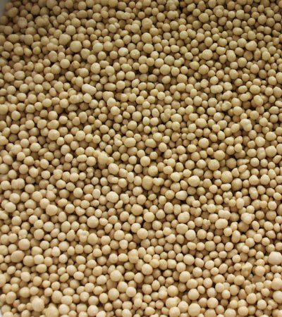
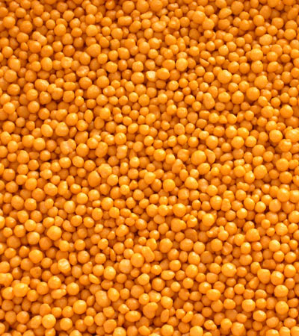
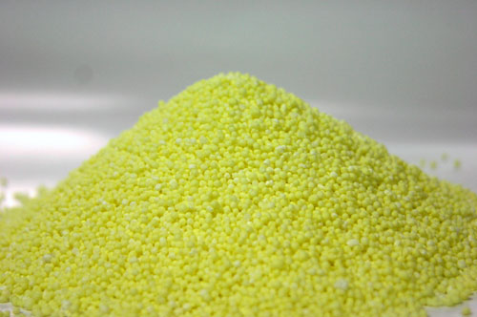
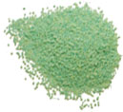
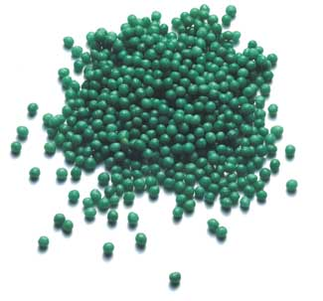
Controlled-Slow Release
Coated Ureas
Sulfur Coat
Polymer Coat
Urea/N Chemistries
Isobutylidene diurea
Ureaformaldehyde
Urea-Triazone
Methylene Urea

Slide 80
Controlled-Slow Release
Two to three (or more) times more expensive than urea or ammonium nitrate
Not used in conventional agriculture, but rather in production systems that are less sensitive to fertilizer costs and which desire a somewhat uniform supply of N to the plants over the cycle
Turfgrass systems:
Advantage of these materials is that one application may provide a uniform supply of N to the plants for several weeks.
S-coated urea (32-36 %N) is urea that has been encapsulated with elemental S in the prilling process. Release of N depends upon breakdown of the S coat (physical barrier)
IBDU (isobutylidene diurea, 31 %N) is another synthetic organic material. N release from this fertilizer depends upon particle size, soil moisture content and pH.
Urea-formaldehyde (38 %N) is a synthetic organic material of low solubility, whose N release depends upon microbial breakdown and thus is temperature dependent.

Slide 81
N Stabilization
Urease Inhibition
Basically prevents/slows urea’s conversion to ammonia
If ammonia (gas) is formed in absence of moisture or soil surface it will be lost to the atmosphere
H₂O
SOIL
(NH₂)₂ CO₂

Slide 82
Urease Inhibition
NBPT: Studied since the 80’s Agrotain
Patent Expired: Currently looking at 8 formulations
(MIC) Maleic Itaconic Coploymer Ca Salt: binding of nickel ions necessary for the formation and function of the enzyme
Nutrishpere
Well studied compound, highly mixed results
ATS: Low pH

Slide 83
To Use or Not to Use
When less or not beneficial
Incorporated
Rain or irrigation of ½ “ or more
Soil and air temp < 50
Dry soil and Air
Banding
No rain expected for 14+ days
UAN vs Urea

Slide 84
To Use or Not to Use
When more beneficial
Surface applied
No-till
High humidity
Light rains, heavy dews, mists
Soil and air temp > 50
Wet soil
Soil with high pH >7.5 Lots of OH in soil
Rain within 10 days

Slide 85
N Stabilization
Nitrification Inhibition
Basically prevents/slows ammonium’s conversion to nitrate
Ammonium(+) is immobile in the soil Nitrate(-) is mobile. In high rainfall, irrigated, well drained soil NO₃ is easily lost.
NO₃ can be lost by leaching and Denitrification
Both Take WATER!!!!

Slide 86
Nitrification Inhibition
Nitrapyrin- Registered Pesticide, studied since the 60’s N-Serve
(MIC) Maleic Itaconic Coploymer Ca Salt: binding of copper ions necessary for the nitrification process Nutrisphere
DCD – Suppresses, does not kill nitrosomas
ATS – Low pH

Slide 87
Site Specific Probability
National Corn Handbook NCH-55, Nitrification Inhibitors in Corn Production

Slide 88
Diammonium Phosphate (18-46-0).
With time, cultivated soils became increasingly deficient in N and the fertilizer industry recognized the increased value of fertilizer materials containing both N and P.
Reacting phosphoric acid with ammonia produces ammonium phosphates, which have become the most popular form of P fertilizers in use today.
Diammonium phosphate, or DAP as it is commonly referred to, is the most popular.
Monoammonium phosphate (11-52-0, MAP) differs from DAP only in its more concentrated grade and that dissolves to form a slightly acidic solution instead of the basic solution formed from DAP.
Both are solid granular materials that can be easily blended with other solid fertilizers.

Slide 89
Ammonium Polyphosphate (10-34-0, APP)
This fertilizer is a liquid, and although it is usually considerably more expensive on a cost/lb P2O5 basis, it is gaining in popularity because of the convenience in handling liquid compared to solid materials.
When DAP, MAP, APP, and TSP have been compared in research trials at the same application rate of P2O5, effectiveness in correcting deficiencies has been equal. Selection of one P fertilizer over another should be made based on availability, convenience, and cost/lb P2O5.

Slide 95
N Application Methods
Broadcast
Incorporated
Non Incorporated
Dry
Liquid
Injected
NH3
Liquid
Dry
Banded

Slide 96
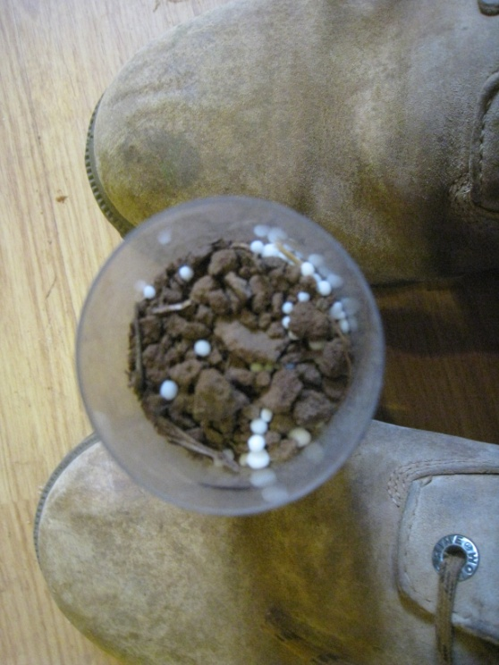
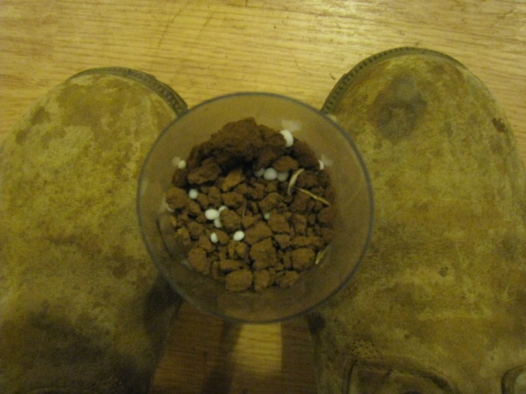
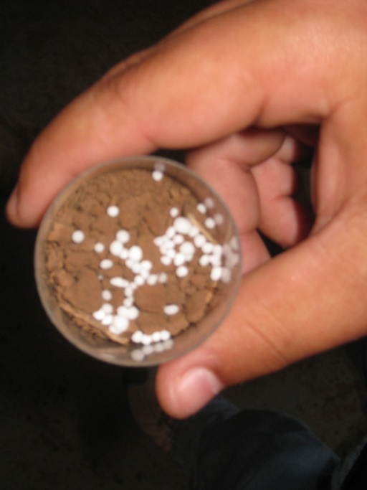
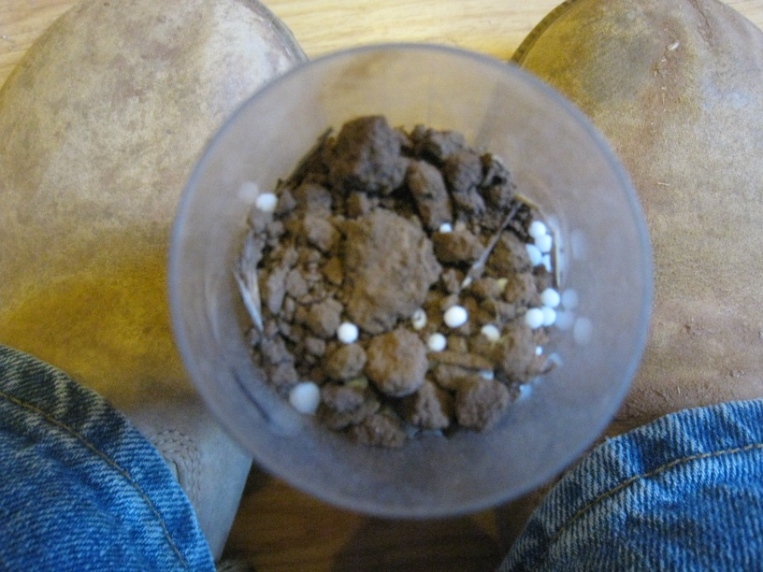
Dry 1 3 6 9

Slide 97
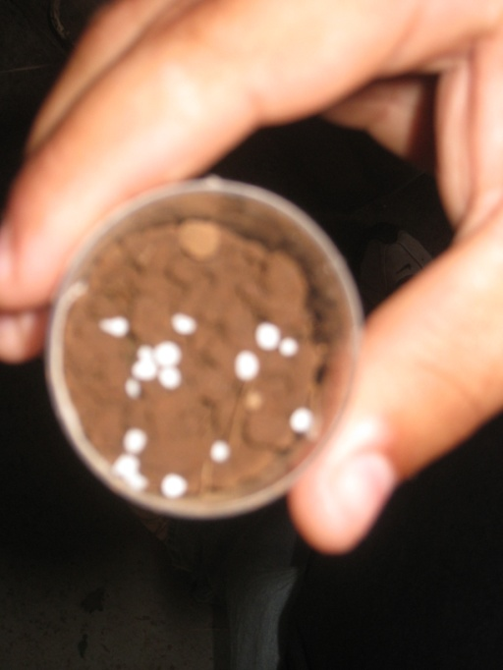
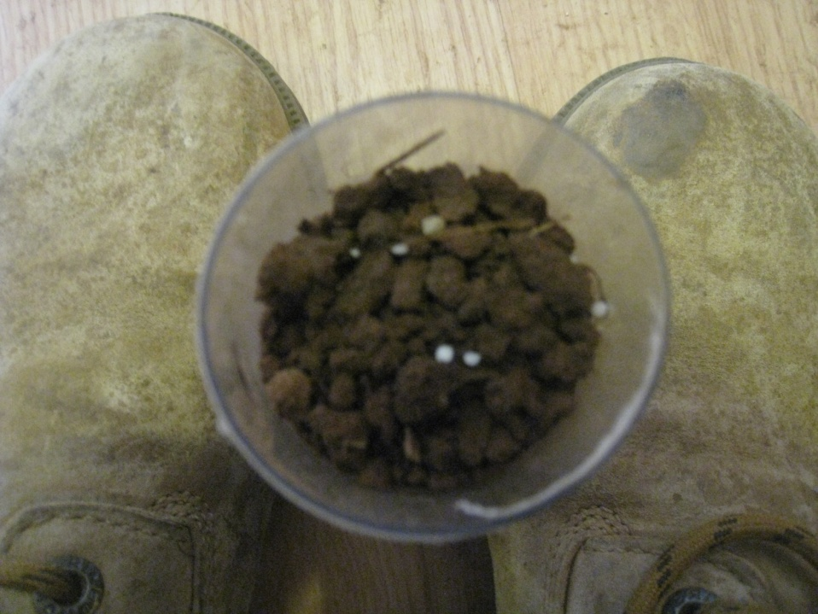
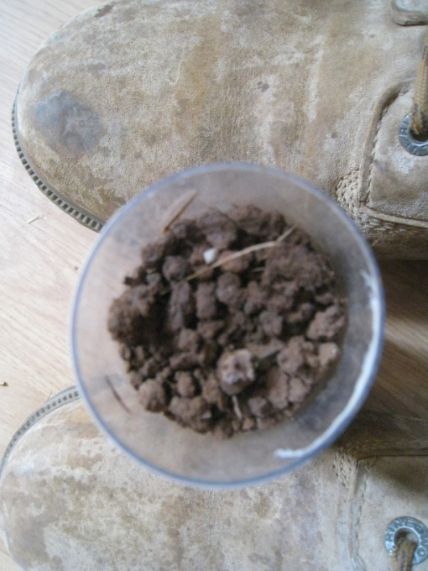
Mist 012

Slide 98
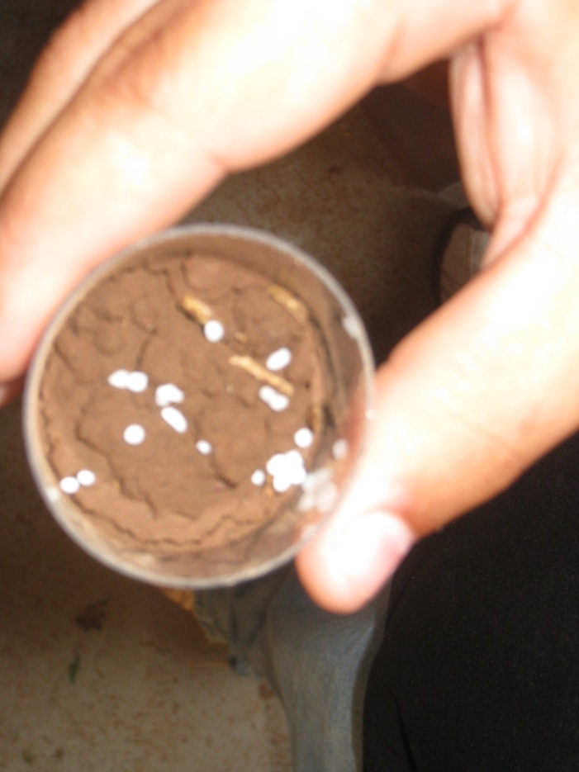
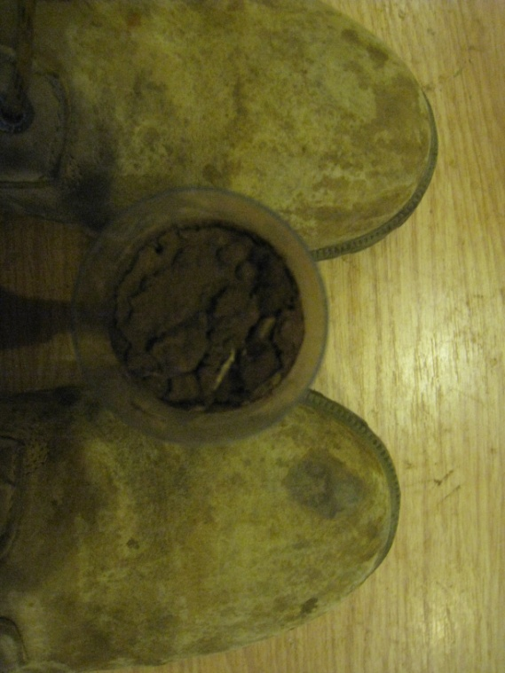
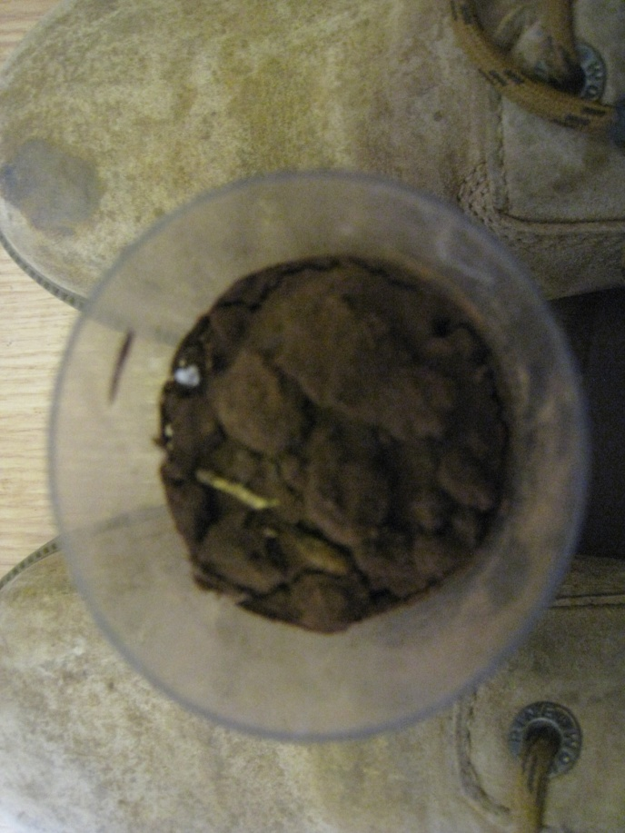
Rain 1 2 3

Slide 99
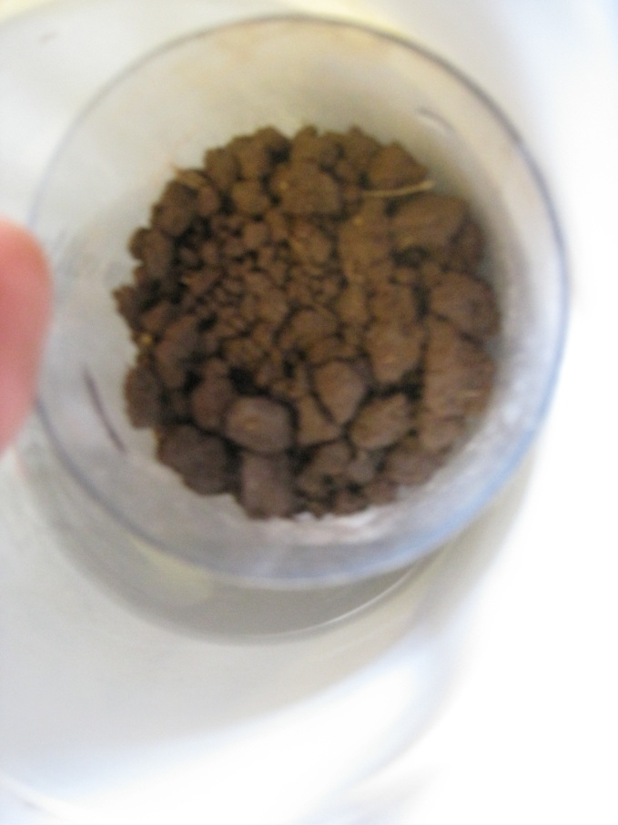
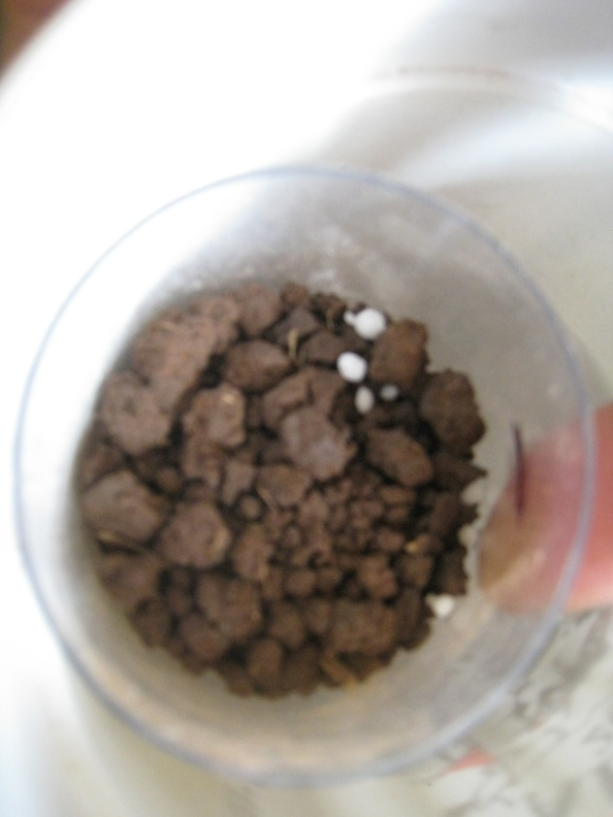
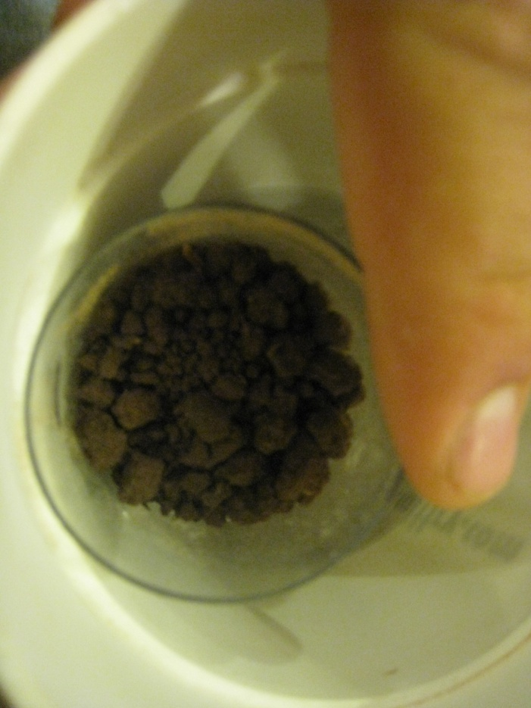
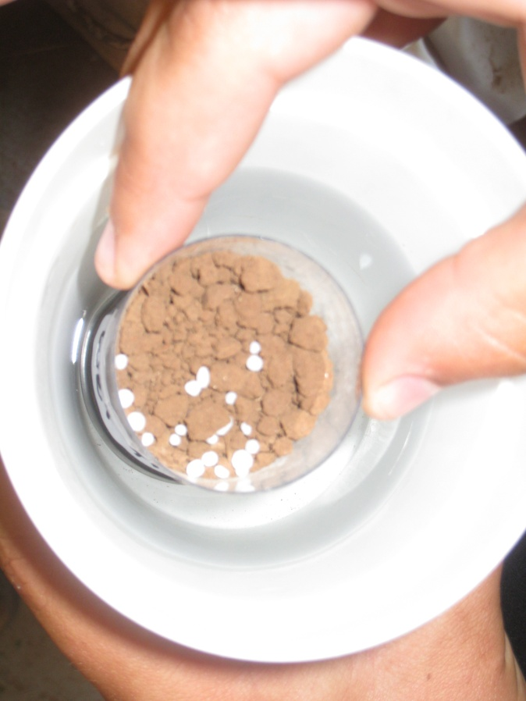
Sub soilwet 1 2 3

Slide 100
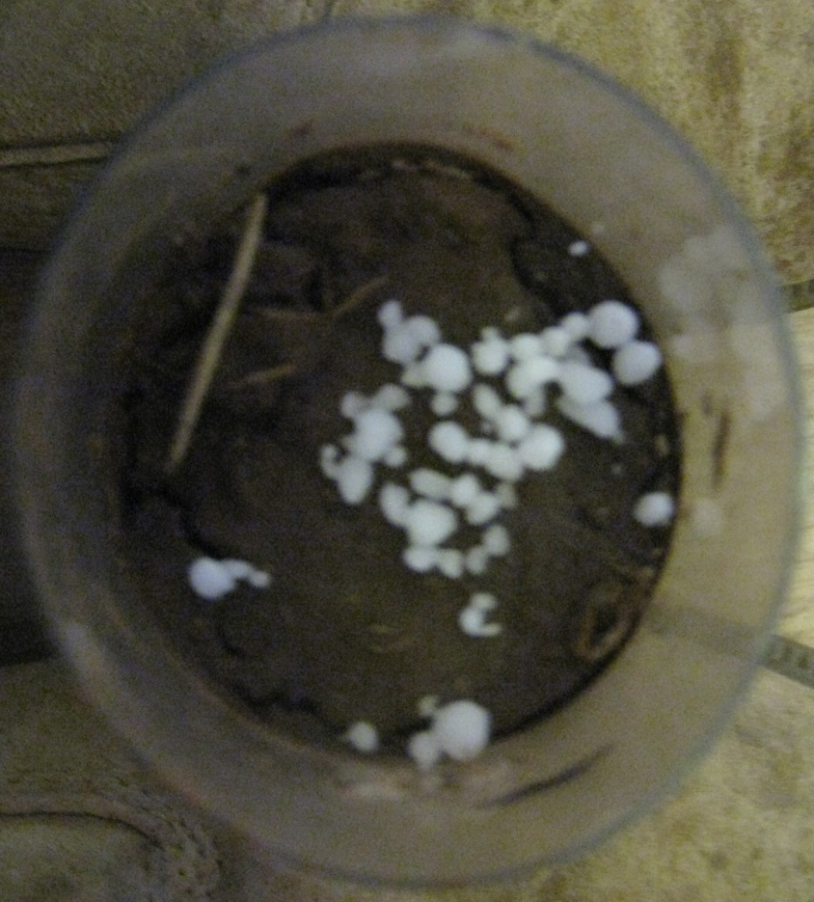
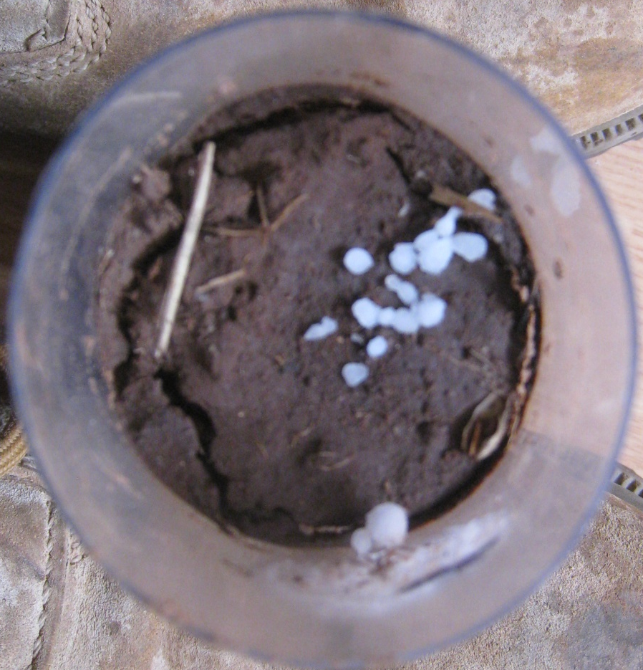
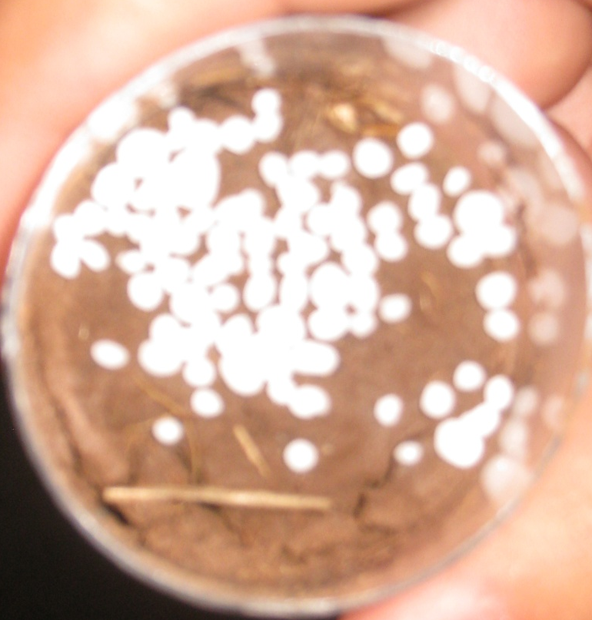
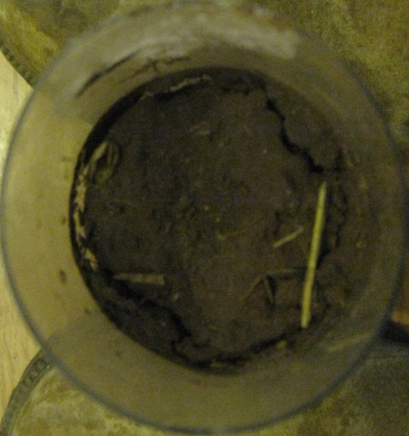
Wet 0 1 2 3

Slide 101
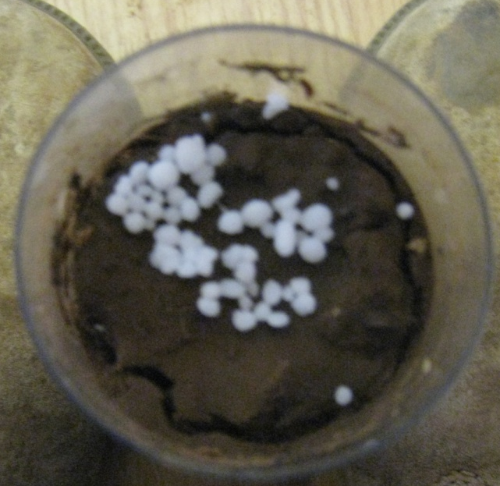
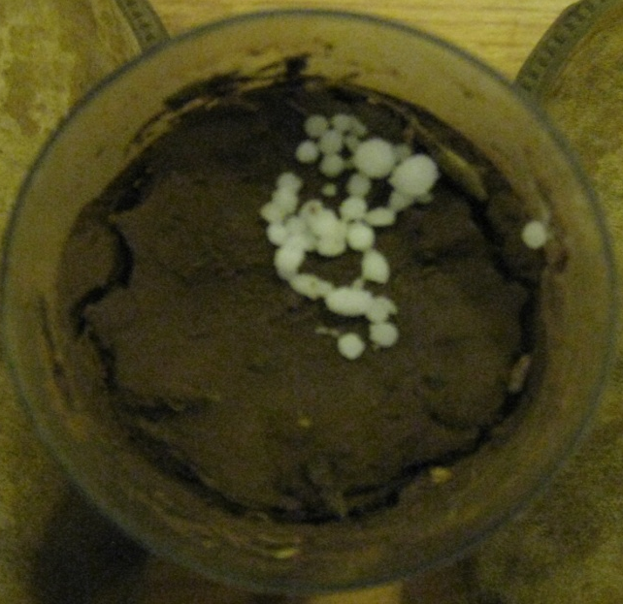
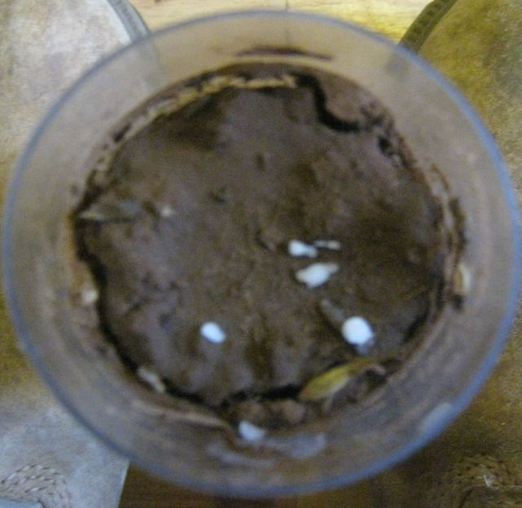
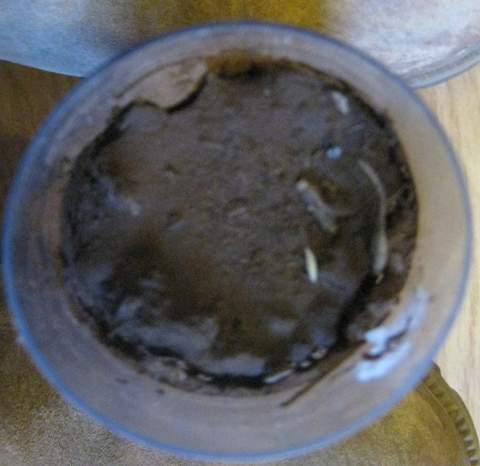
Wet fridge 1 3 6 9

Slide 102
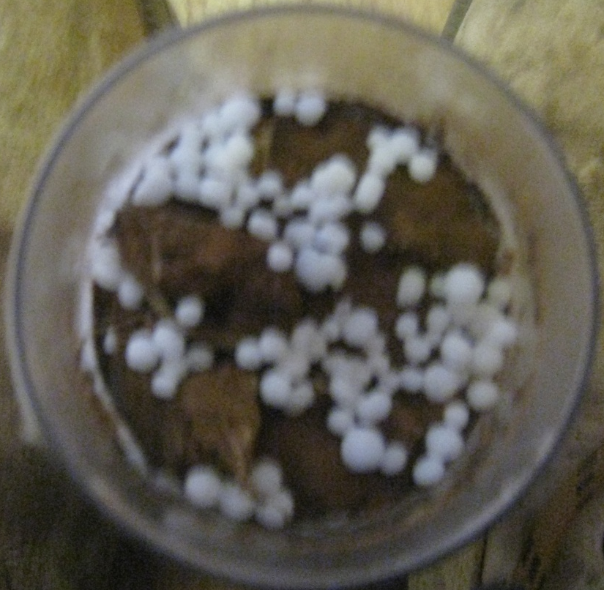
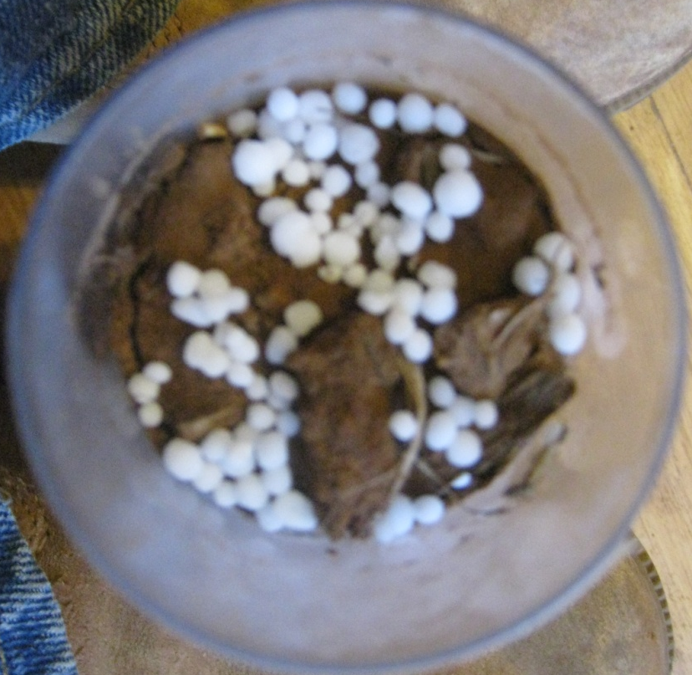
Wet freezer 1 9

Slide 103
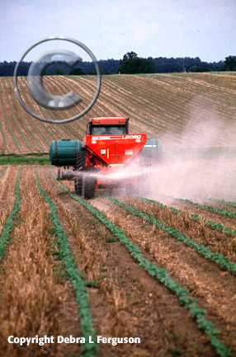
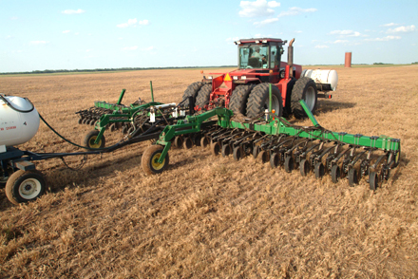
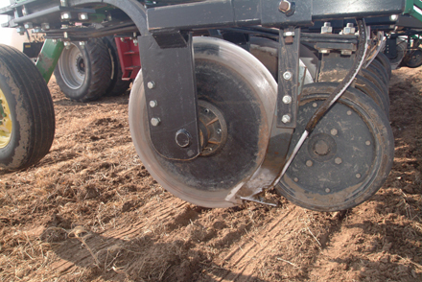

Slide 104
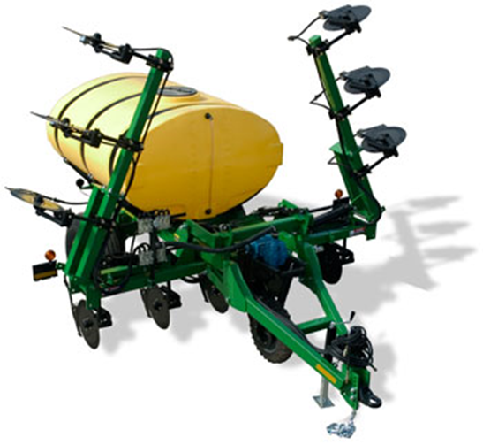
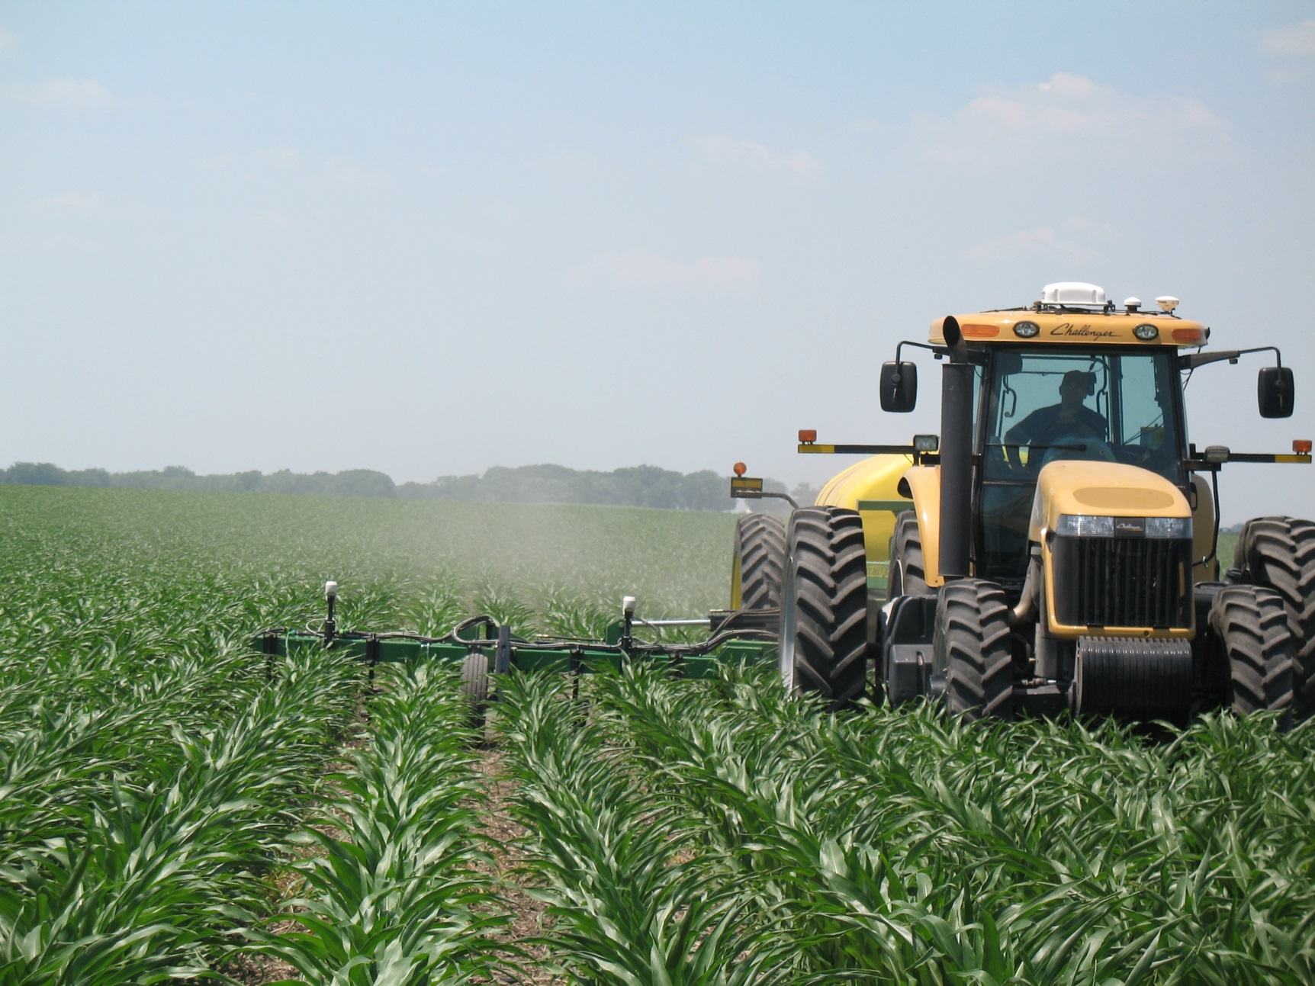
Notes:
Clarifying the standard GreenSeeker commercial nitrogen recommendation.
NRS makes good sense even without GreenSeeker

Slide 105
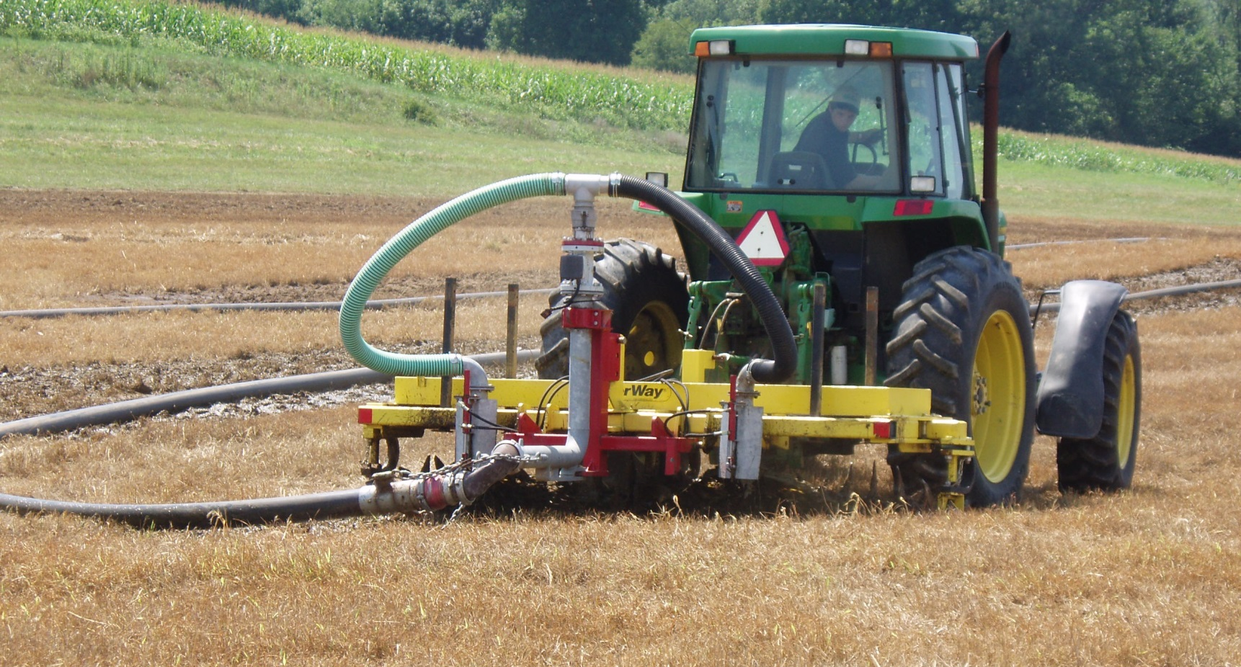

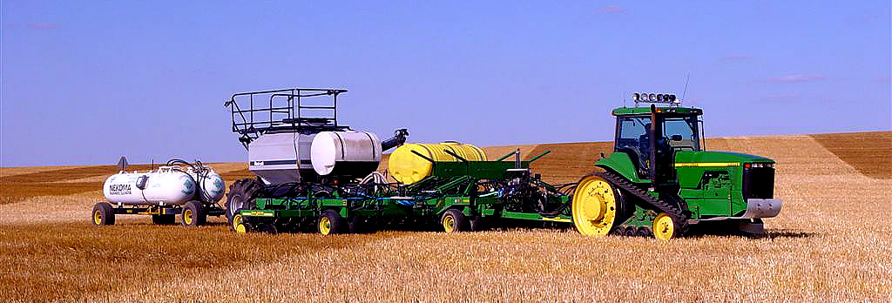

Slide 106
